Slide 1
Welcome!
Regional Performance Appraisal Workshop
Fall 2016
Notes:
Author: Joseph L. Donaldson
Reviewers: Beth Duncan, Shirley Hastings, and Connie Heiskell
[Preparations:
Review these slides and script. Practice the presentation and plan time for breaks and lunch.
Note that activities are included with some suggested times. These times may need to be adjusted depending on the size of your group. Plan for adequate discussion and “de-briefing” time for these activities.
Two flipcharts and markers are needed. One should be titled “Definitions” and this is for any terms or phrases that the participants would like to see defined and listed in the Appraisal Manual, Appendix B, Definition of Key Concepts. The second flipchart is for “Questions” that the regional director would like to confirm with Shirley Hastings and Beth Duncan.
Distribute the appraisal manuals as participants arrive. Welcome all of the participants and introduce any new employees. You will receive an apprasial manual for each employee from Brandi Berven.
Either distribute copies of the IAP Protocol or have it ready to show participants online. The URL is: https://extension.tennessee.edu/eesd/Pages/PerformanceAppraisal.aspx]

Slide 2
Overview and Preview
Notes:
The regional directors, programs leaders, and area 4-H specialists all participated in a similar workshop to today’s event in August. We are so excited about this new appraisal system! We would like to take the next few minutes to provide a brief overview of our initial impressions and preview some of the changes for you!
[It is suggested that this part of the training not be rushed. Participants will be interested in your opinions. Each director, area 4-H specialist and program leader will share their impressions to help “preview” the new appraisal system. Suggestions include:
We now have ONE shared form for UT and TSU. This is exemplary example of cooperation.
Excited that the appraisal factors and criteria were aligned with job descriptions and PDQs from actual agents, county directors, and area extension specialists.
With this new appraisal system, it will be important to update your profile in SUPER: achievements, professional organizations, etc.
We have standard definitions that will give us consistency statewide such as professional development, professional organizations, and base programs.
We have an outstanding, descriptive appraisal manual that will give us consistency statewide across counties and regions.
The entire approach to performance appraisal is streamlined.
County and regional directors now have clear instructions on how to conduct an effective appraisal interview.
The factors, criteria, descriptions are forms were developed by a very hard-working team of your peers and carefully reviewed.
Excellent alignment between IAP, SUPER impact statements, appraisal criteria, and the way we actually work.
Love the timeline! We no longer have to conduct appraisal interviews before the Christmas break. The schedule will be much, much better with appraisal interviews conducted in February. This allows the agent’s work for the entire performance period to be considered.]

Slide 3
Top Ten Exciting Things about the New Appraisal System
10. No attachments
9. Simplified and SUPER-fied
8. Based on REAL job descriptions
7. Easy-to-use manual
6. FINALLY, a definition for base programs
5. Developed by an Extension team that worked hard, had fun, ate well, and made it look easy
4. Administration bought it
3. Under-budget and ahead of schedule
2. One shared form for both TSU and UT
1. It only happens ONCE a year
Notes:
Here are the top ten exciting things about the new appraisal system! [This is an animated slide. Each item will appear on click.]
10. No attachments
9. Simplified and SUPER-fied
8. Based on REAL job descriptions
7. Easy-to-use manual
6. FINALLY, a definition for base programs
5. Developed by an Extension team that worked hard, had fun, ate well, and made it look easy
4. Administration bought it
3. Under-budget and ahead of schedule
2. One shared form for both TSU and UT
1. It only happens ONCE a year
[This list was authored by Shirley Hastings, Beth Duncan, and Joseph Donaldson. It was originally presented to Regional Directors, Program Leaders, and Area 4-H Specialists on August 9, 2016.]

Slide 4
Workshop Objectives
After this workshop, you will be able to:
Explain Extension’s new performance appraisal system for Extension Agents, Area Extension Specialists, and County Directors
Understand how to conduct the performance appraisal
Describe how employee goals are used to develop employees, guide performance, and promote communication between supervisors and employees
Discuss how performance is assessed
Notes:
After this workshop, you will be able to:
Explain Extension’s new performance appraisal system for Extension Agents, Area Extension Specialists, and County Directors
Understand how to conduct the performance appraisal
Describe how employee goals are used to develop employees, guide performance, and promote communication between supervisors and employees
Discuss how performance is assessed

Slide 5
Objective One
Explain Extension’s new performance appraisal system for Extension Agents, Area Extension Specialists, and County Directors

Slide 6
Key Terms
Performance Appraisal
Performance Factor
Criteria
Description
Base Program
Notes:
An understanding of five key terms is essential for achieving the objectives of this workshop and making the most of the appraisal system.
Performance Appraisal – Performance Appraisal is the process of interpreting and measuring the degree of effectiveness, standards achieved, or performance goals met (Bernardin & Beatty, 1984).
Performance Factor – Performance factors are the major categories of performance criteria. Look on the appraisal form. Notice there are five performance factors: (1) program development, (2) program management, (3) program accomplishments, (4) professionalism, and (5) community and organizational leadership.
Performance Criteria – Performance criteria are the 16 principles or standards by which performance is assessed. Notice the criteria on the form.
Description – All performance criteria include descriptions for the five-part scale except for the individual annual plan which only has two descriptions. See Appendix A for the descriptions.
Base Program – Appendix B (page 53) lists some key concepts. Notice the definition of base program.
Please take the next 5-7 minutes to read it silently to yourself.
This is important because it provides clarity and consistency in the way we address our programming and reporting.
I want to emphasize that you as an individual employee are best positioned to determine if a given program will be reported as part of your individual annual plan or as part of base programming.
You will still have impact statements for both base programs and individual annual plans. So, please think about that as you create your individual annual plan.
We will make a list any terms where you would like a standard definition. For example, in reading the descriptions, if a term or phrase is not evident to you, let us know! We want to add the term or phrase to this list.
This list will be shared with the UT and TSU Human Resource Officers. They will collaborate with members of the performance appraisal revision committee to propose definitions to Extension administration. I will not share your name, just the list of terms and phrases for their consideration.
[Use newsprint to record any applicable terms or phrases at each workshop. After the workshop, the regional director should send the list to Shirley Hastings and Beth Duncan. Thank you!]

Slide 7
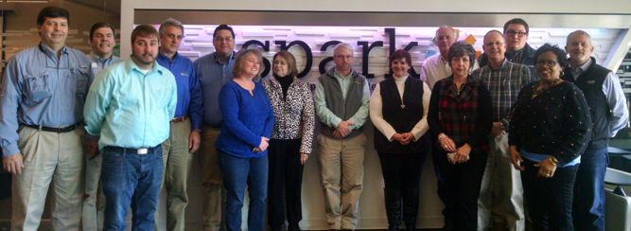
Appraisal Revision Team
Notes:
The University of Tennessee and Tennessee State University have excellent cooperation in programs. One-third of Tennessee counties have both TSU and UT Extension programs. Agents successfully work side-by-side to deliver outstanding Extension programs to the people of Tennessee. Despite this cooperation, the two institutions have had separate Performance Appraisal systems. In October 2014, a team of 18 UT and TSU personnel were appointed to the Performance Appraisal Revision Team and charged with developing one joint appraisal form, criteria and process to be used by both organizations. Three job titles included: Extension Agents, Extension Agents and County Directors, and Extension Area Specialist.
The team is pictured here, and members were as follows.
State: Joseph Donaldson, Tom Broyles, Beth Duncan, Hunter Isbell, Latif Lighari, Tyrone Miller, Izetta Slade, Shirley Hastings, and John Toman
Eastern: Connie Heiskell, Justin Thomas, and Glenn Turner
Central: Mary Beth Henley, Martin Koon, Dallas Manning, and Anthony Tuggle
Western: Troy Dugger, Tracy Hagan, and Gary Rodgers
[Recognize any committee members in the audience. Thank them for their service.]
The team was chaired by Dr. Joseph Donaldson of 4-H Youth Development, Agricultural Leadership, Education, and Communications. Some of the specific objectives of the project included:
Streamline forms and provide one shared UT and TSU form that is acceptable to both Universities’ human resource offices.
Streamline the performance appraisal review process.
Eliminate endless attachments.
Create, confirm, and simplify criteria used for performance appraisal.

Slide 8
Guiding Principles
Research-based
Encourage ongoing communication and feedback
Fair, transparent, consistent
Continuous improvement
Education for all Extension employees
Accountability and personnel decisions
Notes:
The committee’s work reflected six principles that guided their discussion, decisions, and work:
Provide a research-based, efficient, and high functioning appraisal experience that reflects excellence of UT and TSU
Encourage ongoing communication and feedback to enhance positive professional growth and development
Provide a performance appraisal experience that is effective, fair, transparent and consistent
Foster an environment of continuous improvement that elevates performance management and professional development
Provide education and training to all Extension employees to ensure a successful performance management experience
Provide a legal document that improves accountability and informs personnel decisions
You will see these principles in all facets of appraisal such as setting goals, assessing performance, and conducting the appraisal interview.

Slide 9
Appraisal Revision Background
Document review
Appraisal forms
Applicable research
Administrative review
Extension Agent review
HR review
General counsel
Notes:
Document Review
The committee pulled a random sample of 105 County Directors, Extension Agents, and Area Extension Specialists which was 31% of the workforce. This sample was stratified by position (25% county director, 69% extension agent, and 6% area specialist).
The committee them reviewed PDQs and job descriptions for all 105 individuals.
Appraisal Forms
The committee studied appraisal forms from the Univ. of Florida, Florida A&M Univ., Univ. of Kentucky, Virginia Tech and Virginia State.
All of those institutions used a five-part scale to assess performance for County Directors, Extension Agents, and Area Extension Specialists.
Applicable Research
The committee examined applicable research defined as major studies of the job competencies and appraisal systems of County Directors, Extension Agents, and Area Extension Specialists.
Administrative Review
An extensive administrative review was conducted in which regional directors, program leaders, assistant deans, and the dean reviewed the factors, criteria, descriptions, and form.
Extension Agent Review
Regional directors selected the nine highest performing extension agents; six were UT employee and three were TSU employees.
These employees were asked to review the factors, criteria, descriptions, and form.
This group provided very positive feedback about this new approach, specifically, (1) they endorsed the idea of no attachments; (2) liked the presentation of goals, and (3) they requested that supervisor comments be required on each performance factor.
HR Review
The factors, criteria, descriptions, and form were then submitted to both UT and TSU human resource departments, and both departments endorsed the entire effort.
General Counsel
The factors, criteria, descriptions, and form were then submitted to both UT and TSU general counsel, and lawyers from both institutions endorsed the entire effort.

Slide 10
Factors and Criteria
Program Development
Individual Annual Plan
Program Management
Implementing
Evaluation
Reporting
Resource Management*
Program Accomplishments
Base Programs
Equity, Access, and Opportunity
Outcomes/Impacts
Professionalism
Customer Service
Policy Compliance
Professional Development
Technology and Innovation
Work Habits
Community and Organizational Leadership
Interpersonal Skills*
Leadership*
Optimizing Human Capital*
Notes:
All of that work resulted in the appraisal factors, criteria, forms, and processes that we have now. The criteria is shown on the screen. Notice that those criteria marks with an asterisk (Resource management, Interpersonal Skills, Leadership, and Optimizing Human Capital) include additional description to reflect the County Director role. This will be implemented beginning with your 2017 individual annual plans.
[You may want to provide 5-10 minutes for all participants to review the criteria and descriptions found in Appendix A of the Appraisal Manual.]

Slide 11
Appraisal Form
Page One
Standard employee information
Factors, criteria, and points
Page Two
Averages
Overall ratings and total points
Review of goals for the current year
Page Three
Establishment of goals for the coming year
Comments and signatures
Notes:
Please look at the three-page appraisal form on pages 55-57.
Page One
The first page includes the standard employee information such as name, UT IRIS personnel number or TSU T number, and position name.
It also lists the factors, criteria, and points assessed for performance.
Page Two
The second page shows the averages for the five performance factors. Notice that the program development score is divided by one, the program management criteria is divided by four, the program accomplishments are divided by three, etc. The denominator in each case is the number of criteria within the performance factor.
Notice that the average scores for each performance factor are summed to produce an overall score.
The overall scores correspond to an overall rating: exemplary (23-25 points), exceeds expectations (19-22 points), meets expectations (15-18 points), needs improvement (10-14 points), and unsatisfactory (9 or less).
The review of goals for the current year is shown on the second page. Notice that the goal will be listed along with supervisor comments, and the supervisor will also indicate their assessment of the goal as accomplished, progress, or no progress.
Page Three
On the last page, you will note the establishment of goals for the coming year (description, timeframe, and evaluation); supervisor comments; employee comments; and signatures.

Slide 12
Calculation
Sum of Program Development Criteria Rating 5/1 = Supervisor Comments*: Overall a very good document with effective needs assessment, plans for the coming year, and outcomes. | 5
Sum of Program Management Criteria Ratings 17/4 = Supervisor Comments*: You continue to do excellent programming. Strive to improve physical office environment. | 4
Sum of Program Accomplishments Criteria Ratings 14/3 = Supervisor Comments*: Great work. | 4
Sum of Professionalism Criteria Ratings 23/5 = Supervisor Comments*: You continue to demonstrate excellent professionalism. | 4
Sum of Community and Organizational Leadership Criteria Ratings 14/3 = Supervisor Comments*: Your work with staff and volunteers is outstanding. | 4
Overall Score = | 21
Notes:
Now, let’s calculate an example to ensure that everyone understands the averages for the performance factors, overall score, and calculations. Feel free to use a calculator and have a sample form in front of you for reference. Notice that an example is shown on the screen. The performance is rated for each criterion.
For program development, the employee received a five. Five divided by one equals 5.
Notice we are just following the description on the form, “Sum of Program Management Criteria Ratings divided by four.” The sum was 17 and we are diving by four because that’s how many program management criteria there are. 17 divided by 4 is 4.25. SUPER will display 4. No consideration will be given to decimals.
For program accomplishments, the employee received a sum of 14 from the three criteria; 14 divided by 3 is 4.6. Again, no consideration will be given to decimals and SUPER will display the number 4.
For professionalism, 23 divided by 5 equals 4.6; again, SUPER will display 4.
For Community and Organizational Leadership, 14 divided by three equals 4.6. Once again, ignoring the decimal, the employee receives a 4 for Community and Organizational Leadership.
The overall score is 21. If one place past the decimal is considered, the overall would have been 23. In calculating the scores, there will be no rounding, and SUPER will implement this consistently for all employees. This was an administrative decision. It is consistent with UT and TSU policy. It was reviewed and approved by both UT and TSU HR and General Counsel. By not using decimals, it simplifies the entire process.
While we are here, I do want to bring attention to the example supervisor comments. [Read a couple of the comments.] Notice how these comments are clearly based on performance and work habits. The comments are encouraging and instructive, and they focus on the performance factor and/or the criteria within that factor.

Slide 13
Comparing Current (2001) and New (2017) Appraisal Systems
 | Current (2001) | New (2017)
Word Count | 5,202 | 2,042
Criteria Count | 37 | 16
Notes:
This chart shows how the current appraisal system compares to the new appraisal system.
Currently, the system has 37 criteria; 28 for extension agents and area extension specialists and an additional nine for county directors. The descriptions contain more than 5,000 words.
The new appraisal system has 16 criteria. The descriptions contain just over 2,000 words.
Now, the new system will be used with submission of your 2017 individual annual plans.
2016 appraisals will use the current criteria, and the 2017 appraisals will use the new criteria.

Slide 14
Objective Two
Understand how to conduct the performance appraisal
Notes:
[Show the short film, Be Nice to Penny at: https://www.youtube.com/watch?v=_7CEmBZyGF8 ]
This is a humorous way to illustrate that performance appraisal must be based on the job description! The next portion of our workshop will focus on conducting the apprasial.

Slide 15
Communication Matters
Notes:
Before we get into the details of how to conduct the performance appraisal, I want to take a few minutes to discuss the importance of communication.
As we have discussed today, performance appraisal is a process of interpreting and measuring the degree of effectiveness, standards achieved, or performance goals met. Much more time should be spent listening and coaching employees during the year than is spent on the formal appraisal process and forms. Feedback is critical.
This discussion appears on page 6 of the appraisal manual. I am asking county directors especially to take a few moments this week to carefully consider these questions:
Are you genuinely aware of what the employee is doing during the year?
Does the team you lead suffer from a communications drought at any time during the year?
Do you plan time to briefly meet one-on-one with employees throughout the year to check-in on their performance and coach them to be successful?
Do you stockpile issues? In other words, do you save issues to discuss in the performance appraisal interview rather than addressing them during the year?
Are you addressing performances issues in a timely manner?
Is there adequate communication between the supervisor and the employee so that the employee understands the appraisal process?
What is the employee’s perception of performance appraisal? For an effective appraisal process, it should be seen as a positive process not a negative, “gotcha” process.

Slide 16
Individual Annual Plan
Multi-year planning is discontinued
Email notifications for all status changes
Role of County Director
Returned from RPL no more than two times
Rated, locked IAPs will not be altered
Overall rating and comments
IAP instruction
IAP definitions
Notes:
In researching, selecting, and writing new appraisal performance factors, criteria, and descriptions, the Appraisal Revision Committee had much discussion about the role of the IAP. After sharing some of these concerns with Dr. Tim Cross and Dr. Latif Lighari, they requested written protocol which was reviewed and endorsed by the UT and TSU Extension administrative team. The new protocol is based on four tenants:
The IAP should make positive contributions to both employee and organizational development.
The IAP is the keystone of effective program development and implementation.
The IAP successfully guides local program delivery.
The IAP is aligned with the appraisal’s program development criteria.
Multi-year planning is discontinued - Annual plans are consistent with the current annual appraisal criteria for program development, and very few agents and area specialists employed multi-year plans. However, given that issues may take multiple years to address, it is recommended that a function be added to SUPER to allow a plan to be copied from a previous year. The employee would then make any applicable changes and submit the plan. This annual review is important to ensure that (1) programs remain flexible and responsive to emerging needs, and (2) successful past programs are built upon so that the results advance from short-term to long-term outcomes.
Email notifications for all status changes – With all status changes to the IAP, email notifications will now follow to Agents and County Directors. In the past, all of these notifications were not automatically sent to County Directors. This will be a very positive change as County Directors have an integral role in employee coaching and development. Notifications may alert them to provide assistance to employees regarding program development.
Role of County Director – The role of the County Director in the IAP process has been clarified, and that role description has been posted in SUPER. It reads: “The County Director has an important role in the development, approval, and implementation of high-quality programs reflected in the Extension Agents’ IAP. The County Director should coach Extension Agents on matters of program development to ensure that educational programs address the needs identified in the county. This includes coaching Extension Agents on the following varied activities: assessing needs, working with Advisory Groups, identifying issues, setting priorities, targeting an audience, and selecting outcomes. The IAP should reflect the ongoing communication between County Director and Extension Agent throughout the year. The County Director should provide appropriate and timely feedback, including any suggested revisions, about the IAP to the Extension Agent. The County Director submits the IAP to the Regional Program Leaders for approval.”
Returned from RPL no more than two times - IAP will be returned to an employee from the Regional Program Leader no more than two times. This will contribute to efficiency.
Rated, locked IAPs will not be altered – The new appraisal criteria allows for situations where the planned programs and outcomes may change during the year. Also, program changes may often be represented in base programming efforts. Therefore, IAPs will not be altered during the year even though your work may in fact change depending on the circumstances of the county or area you are serving.
Overall rating and comments – The IAP overall rating (program development rating) and overall comments made by the Regional Program Leader will transfer from the employee’s IAP to the appraisal form. Transferring the IAP program development ratings from the IAP to the appraisal form has worked very well for many years for the organization. Notice that there’s only a single program development rating now, not separate ratings for needs assessment, plans for the coming year, evaluation, etc.
IAP instruction – Beginning in 2017, an Annual IAP In-service will be offered statewide to review effective planning, address questions, and concerns among Regional Programs Leaders, County Directors, Extension Agents, Area Specialists, and State Specialists. Potentially, this will be a 90-minute, annual webinar. One of the main goals will be to enhance consistency in implementing this important process across all counties and regions
IAP definitions – Definitions have been added to each screen of the Individual Action Agenda. We believe these definitions will provide clarity and contribute to consistency in preparing and rating Individual Annual Plans.
One additional change was that the “14-day clock” has been eliminated. The RPL will lock the IAPs.
[Show the participants where the IAP Protocol is posted online: https://extension.tennessee.edu/eesd/Pages/PerformanceAppraisal.aspx]

Slide 17
Roles and Responsibilities
Regional Director
County Director
Regional Program Leader
Human Resources Staff
Notes:
It is important that everyone understands the responsibilities of different positions in the organization relative to appraisal. These responsibilities are consistent with the different job descriptions for these roles.
The regional director:
Provides instruction and answers questions in the appraisal process for all personnel in the region.
Coordinates and advises county directors in the appraisal process.
Finalizes ratings and comments in coordination with the county directors.
The county director:
Reviews the IAP and makes any applicable suggestions.
Coaches the agents and answers questions in all aspects of the appraisal process.
Makes preliminary ratings and comments.
Conducts the appraisal interview.
The regional program leader:
Reads and rates all individual annual plans which produces the program development score.
Responds to questions from the regional director and/or the county director regarding the performance of individual employees.
The human resources staff:
Provides instruction and answers questions in the appraisal process from regional directors and others.
Addresses questions and issues from regional directors regarding the appraisal process and forms.
All individuals have a role in understanding the appraisal process, performance factors, criteria, and in implementing a confidential appraisal process.

Slide 18
Process
IAP
Process – see pages 10 and 11
Extension Agents
County Directors
Area Extension Specialists
Enhanced Annual and Annual Reviews
Rebuttal
Notes:
Extension work has a relatively long business cycle that often occurs over a 19-month period. This business cycle may be described in three phases:
Phase I – focuses on needs assessment and planning to produce a plan for the coming year and may occur over a five-month period;
Phase II – involves a 12-month period of delivering, reporting, and evaluating educational programs; and
Phase III – consists of the appraisal process, occurring over three months, for the previous performance period.
To add to the complexity, business cycles overlap so that when appraisal is being completed for one year, the new year has already started! This makes it imperative that supervisors and employees study the appraisal process so that it is implemented fairly and consistently across counties and regions.
IAP – We have already discussed the IAP Protocol. I would like to emphasize that the performance appraisal and annual planning deadlines cannot be achieved with lengthy plans. An efficient process requires a streamlined and reasonable approach to annual planning without multiple reviews, edits, and resubmission of plans. Notice the discussion on page 10 of the Appraisal Manual regarding new employees:
Extension Agents, County Directors, and Extension Area Specialists who have a start date of January 1 through June 30 will create an IAP for the remainder of the current year. These employees will be coached by county directors and regional program leaders in conducting a needs assessment, learning about the county/area they are assigned, and creating an IAP for the remainder of the current year. While the timeframe for completing the IAP and the timeframe covered in the IAP will be different, all other aspects of the appraisal process will be the same as employees who have worked more than one year.
Those hired on or after July 1 will not have an IAP during the year of the appraisal. These employees should be coached by county directors and regional program leaders in conducting a needs assessment, learning about the county/area they are assigned, and creating an IAP for the coming year. Since extension agents, county directors, and extension area specialists hired after July 1 will not have an IAP, their program development score will be zero. The highest these employees can score on the overall appraisal rating is 20 total points, exceeds expectations.
Now that we have discussed the IAP, let’s turn our attention to the appraisal process at the end of the year. The following discussion outlines the appraisal process at the end of the year for Extension Agents, County Directors, and Extension Area Specialists.
Process – Look on page 11 and 12 of the Appraisal Manual. Notice how the process is outlined for Extension Agents, County Directors, and Area Extension Specialists. Take the next few minutes to review those descriptions.
Enhanced Annual and Annual Reviews – All Extension personnel receive annual performance reviews and participate in a formal performance appraisal interview. For Extension Agents and County Directors, the appraisal process allows for an enhanced review every three years. The enhanced review follows the process you just read about on pages 10 and 11. The annual review follows the same process except ratings are finalized by the county director. The enhanced review would be used rather than the annual review as follows:
If the employee is on a performance improvement plan, only the enhanced review is used.
During a county director’s first year in that role, the enhanced review will be used for all employees supervised by the county director.
If the current year overall score differs by at least five points over the previous year, the review is changed to an enhanced review for that year.
The enhanced review is used in all cases where an employee’s overall rating is needs improvement or unsatisfactory.
Rebuttal – In situations when an employee has reason to disagree with the performance appraisal, the employee may respond to the content or conduct of the performance evaluation in writing within 30 days following the performance appraisal interview between the supervisor and employee.
If an employee chooses this option, the employee's response should be forwarded to their supervisor and a copy should be submitted to the TSU Vice President, Business and Finances, Human Resources (for TSU employees) or the Extension Human Resources Officer (for UT employees). If appropriate, the supervisor may respond in writing within 30 days of receiving the employee’s response.

Slide 19
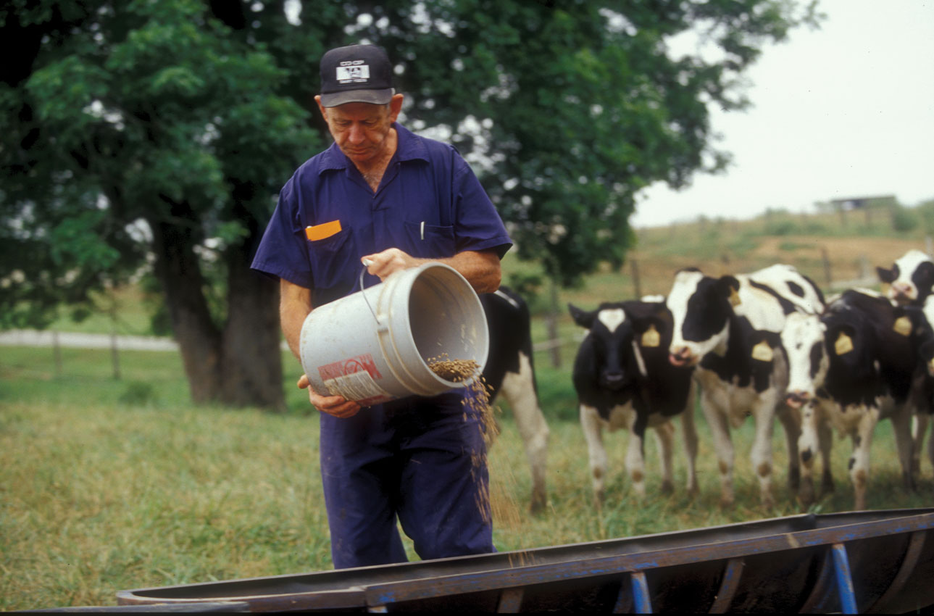
Timeline
2016 Appraisal
2017 Appraisal
Notes:
All 2016 appraisals will follow the current criteria, established in 2001 and revised in 2007. A new goals tab has been added so that when you complete your 2016 appraisal, you will add your “goals for the coming year” or goals for 2017.
Let’s look together on page 15 which has the 2017 appraisal timeline. [Read the schedule point-by-point from page 15. Address any questions from participants.] For 2017, all appraisals will be enhanced annual reviews. This will contribute consistency and provide county directors adequate time to learn and follow the new appraisal system.

Slide 20
Comments
Supervisor Comments
Performance factors
Goals for the current year
Establishing goals for the coming year
Overall comments
Employee Comments
Anything with which you need help
How your supervisor may assist you
Resources needed
Notes:
Supervisors – Supervisors and employees make comments on the appraisal form. Supervisors are required to make comments on each performance factor (program development, program management, program accomplishments, professionalism, and community and organizational development). Supervisors may make comments in reviewing goals for the coming year, establishing goals for the coming year, and overall comments.
Supervisors must be sensitive to the fact that all appraisal forms are legal documents and property of Tennessee State University and the University of Tennessee. Comments about personal matters, including medical/health issues, are never appropriate.
Comments must be instructive and demonstrative in nature and contribute to employee development and achievement of professional and organizational goals.
Employees – Employees are required to make overall comments. Employees are encouraged to describe anything they need help with, how their supervisor can assist on accomplishing goals, and/or resources needed.

Slide 21
Appraisal Interview Best Practices
Conducted annually, privately, and consistently with all employees
Schedule sufficient time to prepare for and conduct the interview
Be cognizant of non-verbal communications
Eliminate barriers
Participate in active listening
Notes:
Pages 16 and 17 of the Appraisal manual cover the appraisal interview.
Supervisors and employees should have discussions regarding performance on a regular basis throughout the year; open dialogue improves performance, programs, and customer service. Employees should receive feedback from their supervisor during the year so that the appraisal interview is a summary of these discussions. Ratings should not come as a surprise to employees. In fact, when ratings come as a surprise to employees, it is indicative of the need for more communication.
The performance appraisal interview is an opportunity to review performance, consider lessons learned, assess progress during the rating period, and establish goals and objectives for next period. However, if there are any disagreements about ratings, handle dissent professionally. Disagreements should be noted as a matter of record either in the comments section of the performance appraisal or via separate documentation following the performance appraisal interview.
To prepare for the performance appraisal interview, supervisors should schedule sufficient time to focus on the interview; one hour is recommended. Choose a meeting space that will be free of interruptions, no interruptions from other staff members, nor interruptions from phone calls or texts. Both employees and supervisors should turn off cell phones during the appraisal interview.
Best practices for conducting the performance appraisal interview include:
Conduct a performance appraisal interview annually with each employee.
Conduct a performance appraisal interview after meeting with Regional Director.
Performance appraisal interviews should only be conducted with the door closed; a private setting ensures that both supervisors and employees feel comfortable talking openly.
Performance appraisal interviews should be conducted on a consistent basis with all employees.
Allow for sufficient time to prepare for and conduct the interview.
Be aware of non-verbal communications: emotions, body language, space and tone of voice.
Eliminate barriers for the appraisal interview. If a small conference table is available, that would be preferred over a supervisor sitting behind his/her desk.
Participate in active listening.
The following topics are essential to an effective appraisal interview:
Express appreciation for the work completed by the employee.
Discuss the performance factors one at a time, and especially discuss those areas that are unsatisfactory, needs improvement, exceeds expectations, and/or exemplary.
Review goals for the current year and discuss the goals for the coming year.
Make sure to ask if the employee has any questions about the appraisal or otherwise.
The following topics are suggested for an appraisal interview:
What is the employee’s biggest accomplishment this year?
What did the employee most improve upon since last year?
What can the supervisor and/or organization do to assist you with programming?
What can the supervisor and/or organization do to assist you with your professional growth?
Are there any resources you need to help you with your programming and/or professional growth?

Slide 22
1. “Agents are trained professionals and wish to be treated as professionals when they’re evaluated on job performance” (Davis & Verma, 1993)
2. “A well- designed and well-executed performance appraisal system could lead to greater efficiency, effectiveness, and improved employee morale” (Davis & Verma, 1993)
3. “Ideally, performance appraisal is a tool used by both parties in the employment relationship to reduce uncertainty by informing [professionals] about job performance, job opportunities, rewards, and sanctions” (Fay, 2006)
4. “[Performance appraisal] should be the basis for professional development of individuals, improvement of the services rendered, and summative decisions made with regard to an employee (merit pay, job placement, promotion, or termination, etc.)” (Donaldson and French, 2013)
5. “The performance appraisal process has become a powerful institution within the employment relationship, having significant impact upon employees” (Fay, 2006)
Notes:
[The next activity may be completed by asking participants to either work with one other person or work in groups of 3-5 depending on the number of participants and the room size.]
In your group, consider all of the quotations. Select one that you would like to discuss. In your discussions, be as specific as possible. For example, if you choose quotation five, provide an example of how performance appraisal impacts you and/or other employees. Now, take the next 5-10 minutes.
[After the participants have had time to work in their groups, bring them back together. Process the activity by reading each quotation one at a time, and allowing participants to share highlights from their discussion.]
This activity had several purposes, including the following
to process what you have learned,
to discuss your experiences with appraisal, and
to provide this entire group a look at how we approach appraisal due to our individual and shared experiences.
We also wanted to highlight effective appraisal.

Slide 23
Objective Three
Describe how employee goals are used to develop employees, guide performance, and promote communication between supervisors and employees
Notes:
Effective goal-setting is a critical part of a successful appraisal system. Goal-setting should:
increase communications between supervisors and employees,
set action plans for the coming year, and
promote overall organization and employee effectiveness.

Slide 24
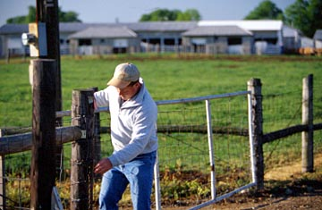
SMART Goals
Notes:
The goal should be SMART goals!
Specific – Specific goals are concrete, detailed, focused, well-defined, straightforward, and action-oriented.
Measurable – Appropriate measures help employees make progress toward completing objectives. Progress measurements also allow for course corrections along the way for both direction and pace. If you set an objective that is measurable, you will have tangible evidence of completion of the objective.
Achievable – Achievable objectives are those that your employee can actually accomplish (something he or she can realistically do within the time frame set), not an aspiration or vision. Achievable objectives need to challenge your employee but not so much so as to be unattainable or to cause frustration in being unable to complete them.
Realistic – Realistic objectives are those that you have the resources to accomplish, including skills, funding, equipment, time and staff.
Time Oriented – Time Oriented Objectives are those that have deadlines for completion. The time frames create a sense of urgency, and lead to action. The deadlines, just as with overall objectives, must be achievable and realistic. For a complex objective, break it into small parts, and set a deadline for completion of each phase (Doran, 1981).

Slide 25
Example A – Review of Goals for the Current Year
Goal 1 | Complete three, one-day inservices on residential horticulture topics. | ✓ Accomplished ◻ Progress ◻ No Progress
Goal 2 | Complete timely and accurate reports: activity reports, 4-H Youth Enrollment, and Civil Rights. | ◻ Accomplished ◻ Progress ✓ No Progress
Goal 3 | Increase extramural funding for sensor technology field days by applying for three grants over the next 12 months. | ✓ Accomplished ◻ Progress ◻ No Progress
Comments | Professional development and extramural funding goals demonstrated accomplishment and positive work ethic. Reporting was unsatisfactory.
Notes:
Notice that the agent created three goals:
Complete three, one-day inservices on residential horticulture topics.
Complete timely and accurate reports: activity reports, 4-H Youth Enrollment, and Civil Rights.
Increase extramural funding for sensor technology field days by applying for three grants over the next 12 months.
The county director indicated that Goal 1 and Goal 3 were accomplished. The county director indicated that the extension agent made no progress on goal 2. Also, notice that the county director’s comments were, “Professional development and extramural funding goals demonstrated accomplishment and positive work ethic. Reporting was unsatisfactory.”
When the supervisor reviews goals for the current year, he/she will indicate one of three dispositions:
Accomplished means that the goal was met as stated.
Progress indicates that the goal was not entirely accomplished but some major progress was made towards meeting the goal during the year.
No Progress indicates that progress was not made and the supervisor and employee should assess the reason(s) why no progress was made. The supervisors and employee should also determine if the goal is appropriate to set as a goal for the coming year.
In many cases, the supervisor will be able to observe whether or not the goal was met. In other cases, the employee’s annual summarized data will indicate whether or not the goal was met. It is appropriate for the supervisor to ask the employee if their individual goals were met.
In addition to marking a disposition of accomplished, progress, or no progress, the supervisor may make comments regarding the goals. If all goals are accomplished, then supervisory comments are not required, but positive reinforcement is certainly recommended.

Slide 26
Example A – Establishment of Goals for the Coming Year
 | Description | Timeframe | Evaluation
Goal 1 | Submit five entries for the TAAA&S Communications Awards Program. | First Quarter, 2018 | Quality is shown by judges’ scorecards.
Goal 2 | Complete timely and accurate activity reports on a monthly basis. | January – December, 2018 | SUPER Delivery and Appraisal summary.
Goal 3 | Complete required background checks on applicable volunteers per University policy. | January – December, 2018 | SUPER Enrollment module will be used to show enrollee records.
Comments | We will establish a monthly meeting time to review progress toward goals, especially reporting and compliance issues.
Notes:
Notice that the agent listed each goal along with the timeframe for achieving the goal, and the method to be sued for evaluating the goal. Goal 1 was to “Submit five entries for the TAAA&S Communications Awards Program.” The timeframe was the first quarter of 2018. This goal will be evaluated by using the judges’ scorecards from the event, and the agent notes that these scorecard evaluate the quality of work.

Slide 27
Example B – Review of Goals for the Current Year
Goal 1 | Continue to teach Tennessee Shapes Up at every school and senior center in the county reaching 400+ in multi-session courses. | ✓ Accomplished ◻ Progress ◻ No Progress
Goal 2 | Begin quarterly individual meetings with all County Extension personnel for improved performance management. | ✓ Accomplished ◻ Progress ◻ No Progress
Goal 3 | Work to improve Extension Office parking lot by sealing, repainting, and improving lighting. | ◻ Accomplished ◻ Progress ✓ No Progress
Comments | Your work continues to show excellent organizational and teaching skills. Continue work to improve the office physical environment including the parking situation.
Notes:
This example is for a county director. Notice that the county director created three goals:
Continue to teach Tennessee Shapes Up at every school and senior center in the county reaching 400+ in multi-session courses.
Begin quarterly individual meetings with all County Extension personnel for improved performance management.
Work to improve Extension Office parking lot by sealing, repainting, and improving lighting.
The regional director indicated that Goal 1 and Goal 2 were accomplished. The regional director indicated that the county director made no progress on goal 3. Also, notice that the county director’s comments were, “Your work continues to show excellent organizational and teaching skills. Continue work to improve the office physical environment including the parking situation.”

Slide 28
Example B – Establishment of Goals for the Coming Year
 | Description | Timeframe | Evaluation
Goal 1 | Work to improve Extension Office parking lot by sealing, repainting, and improving lighting. | January – December, 2018 | Observation and investment of county funds.
Goal 2 | Conduct one volunteer recognition event for all Extension volunteers. | Second Quarter, 2018 | Evaluated by the number of people attending.
Goal 3 | Participate in one or more inservices related to technology for programming and communications. | January – December, 2018 | SUPER Profile will show inservice record.
Comments | We will establish a monthly meeting time to review progress toward goals, especially reporting and compliance issues.
Notes:
Notice that the county director listed each goal along with the timeframe for achieving the goal, and the method to be used for evaluating the goal. Goal 1 was to “Work to improve Extension Office parking lot by sealing, repainting, and improving lighting.” The timeframe was January-December, 2018. This goal will be evaluated by observation and investment of county funds. Another possibility would be before and after photos. Notice Goal 3, “Participate in one or more inservices related to technology for programming and communications.” Regarding evaluation, the county director noted that the SUPER Profile shows a record of inservice.

Slide 29
Goals
Employees set one, two, or three goals
Program goals, personal development, or professional development
Discuss the establishment of goals in December each year
Notes:
Employees may set one, two, or three goals for the year. Goals may relate to personal development, professional development, and/or program goals. As a best practice, professional development and program goals should relate the performance criteria. The following goals are provided for illustration:
Increase County 4-H Honor Club Membership from 40 to 50 members (20% increase).
Complete 12 hours of Extension inservice courses related to forage management.
Become physically active for at least 60 minutes on most days of the week to improve health.
While it is acceptable to create healthy lifestyle goals (such as “Walk 45 minutes every morning”), employees should never disclose personal or medical information on the appraisal form. Key applicable federal and state laws govern how employers must treat employees, including:
The Americans with Disabilities Act (ADA) prohibits discrimination against people with disabilities in employment, transportation, public accommodation, communications, and governmental activities. The ADA also establishes requirements for telecommunications relay services.
The Health Insurance Portability and Accountability Act (HIPAA) mandates the protection and confidential handling of medical information.
As a best practice, supervisors and employees should discuss goals during coaching sessions in December of each year. Ideally, goals would be finalized in December.

Slide 30
Setting and Achieving Goals
Write a goal for 2017
Share your goal
Evaluate using SMART criteria
Notes:
[The next activity may be completed by asking participants to either work with one other person or work in groups of 3-5 depending on the number of participants and the room size.]
Write an example goal that you can use as a goal for the coming year. Share your goal with your group and state if the goal is a program goal, professional goal, or personal goal. Make sure to include a timeframe and tell how you will evaluate the goal. Everyone else in the group will evaluate the goal using the SMART criteria and make suggestions for improvement, if any. Now, take the next 10-15 minutes for this activity.
[After the participants have had time to work in their groups, bring them back together. Process the activity by asking each group for at least one goal. First, ask for a program goal. Next, ask for a professional development goal. Finally, ask for a personal goal. Allow participants to share highlights from their discussion and address any questions that arise. Use these true or false questions below to wrap-up the discussion on goals. Read the question, allow participants to share their answers, and review the correct answers.]
True or False: All employees must write three goals annually. [False, employee are only required to only set one goal. While you may set any number of goals, only three goals appear on the appraisal form.]
True or False: If employees write a personal goal, such as pursuing a healthy lifestyle, it is critically important that they do not disclose their personal health information, such as their weight, on their appraisal form. [True, personal and confidential means just that!]
True or False: As a best practice, supervisors and employees should wait until the appraisal interview in February to discuss goals for the coming year. [False, it is suggested that supervisors and employees discuss goals for the coming year in December.]
True or False: Supervisors should tell each individual employee how many goals to write on their appraisal each year. [False, it is the employee’s choice to submit one, two, or three goals.]
True or False: An employee may receive an overall rating of exemplary while not achieving any of the goals they set for the year. [True, the goals are to promote communications between supervisor and employees, promote overall employee and organizational effectiveness, and set action plans for the coming year. The goals are not specifically considered in assessing the performance. Also, the context of the employee’s job may have changed drastically so that the goals are not longer applicable. That does not create a problem, and there is no need to revise goals after the appraisal form has been finalized.]

Slide 31
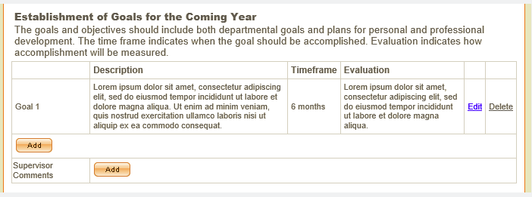
SUPER Goals for the Coming Year
Notes:
This is an example screen shot from SUPER. You will click “add” to add your goal, and “edit” to modify the goal. Notice you can also click delete to start over. When you developed your “goals for the coming year” for your 2016 appraisal, those will transfer to your 2017 appraisal as “goals for the current year”. The actual appraisal form is three pages. All appraisal forms will be three pages. You will have character limits when writing these goals, and a counter (counting down the number of characters you have left) will be available in SUPER to assist you. Just a tip as you get started with this new system: Think about composing your first goal in Word and then copy and paste to see if it fits!

Slide 32
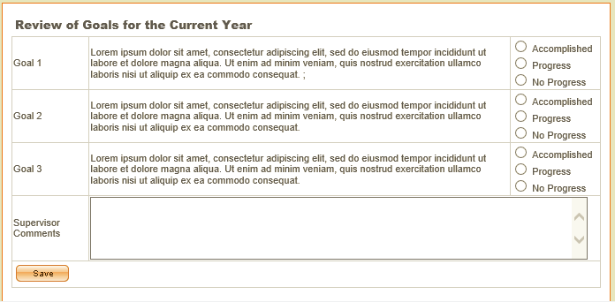
SUPER Review of Goals for the Current Year
Notes:
This is an example screen shot from SUPER. Again, when you developed your “goals for the coming year” as part of your 2016 appraisal, those will transfer to your 2017 appraisal. This screen shows where the supervisor marks accomplished, progress, or no progress. A box for supervisor comments is provided. You will have character limits for these comments, and a counter (counting down the number of characters you have left) will appear in the box to assist you.

Slide 33
Objective Four
Discuss how performance is assessed
Notes:
Objective Four for today’s workshop deals with how performance is assessed.

Slide 34
Assessing Performance
Annual Summarized Data
Suggested Approach
Supervisor’s Files
Information Sources and Alignment to Criteria
Performance Factors Averages
Performance Factors Comments
Notes:
Annual Summarized Data – Annual summarized data from SUPER modules will be displayed in the appraisal for the year of the appraisal. The data elements listed on page 21, when summarized on an annual basis, have utility for appraisal purposes. The data elements are listed with the SUPER module where the data originates. The employee profile data comes from the SUPER profile module, professional development data comes from the training/registration module, and impact summaries come from the delivery module.
[Share a couple of examples from the list on page 21, such as “achievements” which comes from the Profile module.]
The summarized data has a critical role in documenting and measuring performance. Employees should examine the data for self-appraisal and program evaluation and improvement purposes. Supervisors should consider the data for coaching the employee in performance, developing appropriate goals, and making appraisal ratings.
Suggested Approach – Foremost, the employee should have already received coaching regarding major performance issues during the year. As an illustration, if reports are not submitted in an accurate and timely manner, the supervisor needs to coach the employee at the time the report is due. Also, just because coaching took place does not mean the employee will receive a rating of meets expectations or higher. Keeping open lines of communication provides an opportunity for both the supervisor and employee to understand what is causing the performance issue and address it. To continue the reporting example, an employee may not know how to utilize reports to improve programming efforts and/or may not understand what constitutes impact and how to effectively share it with stakeholders. Furthermore, this illustrates the developmental orientation of performance appraisal which should be encouraged rather than a “gotcha” orientation which is unacceptable.
Supervisors should first review the performance factors and criteria. This serves as a reminder of the various performance levels, and it is important before assessing performance so that the review conducted represents the stated criteria. This serves as a reminder and it also contributes to consistency and fairness in reviewing employees with the same job titles. [Ask participants to look at the suggested approach on page 22. Emphasize that the data shown will be only for the year of the appraisal.]
Supervisor’s Files – County Directors should have one file for every employee specific to appraisal. It should include information such as notes, reprimands, letters of commendation, and performance-based examples. Regional Directors should have one appraisal file for every county. To both assess performance and prepare for the appraisal interview, supervisors should review the file, among other information sources.
While these files are important, they are not maintained to “prove” given performance ratings, and they are not more critical than observation and annual summarized data such as impact statements. They are maintained to show examples to employees and look for ways to develop employees and the organization. The files show quality of work in a way that numbers alone may not. The files should only reflect the employee’s performance, knowledge, skills, abilities, and/or behavior.
Note the discussion on page 22 that “While these files are not the official personnel files, they are legal documents, property of the Tennessee State University and the University of Tennessee…..These files, like all personnel information, must be maintained in a locked filing cabinet or computer in a secure location in the Extension office. The files must be kept as long as the individual is employed and three years after they leave employment unless the individual was involved in an appraisal appeal process in which case they are retained forever.“
Information Sources and Alignment to Criteria – Review pages 23-24 in the manual, and note the following:
Table 4 shows alignment between information sources and appraisal criteria. It is critically important that Table 4 not be misinterpreted. The performance appraisal interview is not a presentation. The employee should not be bringing these materials to the supervisor.
Likewise, Table 4 is not an exhaustive list of information sources that may be used to assess performance. The information sources are examples, and in all cases, quality must be considered. Consider an employee who has a record of professional development consistent with their professional development plan and job assignments. However, the employee is chronically late to the professional development sessions. The employee is neither fully participating in the professional development opportunities nor exhibiting positive work habits.
Performance Appraisal Averages – The supervisor rates the employee on the performance criteria which are organized by performance factor. The criteria ratings are summed and averaged within a performance factor to produce a score for each factor. The scores are summed for the overall rating (see page 25).
Performance Appraisal Comments – Supervisors must provide comments for all five performance factors. The comments should be aligned with the performance factor and may represent performance strengths, challenges, areas of improvement, and goals. While the space for comments on the performance appraisal form is limited, an employee should receive other forms of feedback during the year such as coaching during a one-on-one conversation with their supervisor or a letter of commendation from a regional program leader so that comments on the appraisal form summarize previous communications. See the example on page 26.

Slide 35
Performance Considerations
Impact of Leave of Absence
Understanding Low Performance
County Director’s Appraisal Checklist
Notes:
Impact of Leave of Absence – A leave of absence may affect an employee’s quantity of work, but will not necessarily affect the quality of work performed. Supervisors must use care to ensure that ratings and comments cannot be perceived as an adverse action based on the employee’s absence during an approved leave of absence. Doing so may violate federal and state laws.
If an employee is on an approved leave of absence (such as Family Medical Leave, Maternity Leave, and Military Service Leave) during the review period, the actual dates that the employee is actively at work will be recorded on the appraisal form. The employee will be reviewed on work performed during this review period. If an employee is on an approved leave of absence for the entire review period, record this on a performance appraisal form so that a record can be placed in his/her personnel file.
Pages 26 and 27 include a great description of Family Medical Leave Act, Tennessee Maternity Leave Act, and Military Service. Let’s take just a few moments to allow everyone to read pages 26 and 27. [After a few minutes, ask the group if they have questions. Address their questions before continuing.]
Understanding Low Performance – Pages 27 and 28 highlight the causes low performance. The supervisor should consider causes of low performance (ratings of unsatisfactory and/or needs improvement). Ineffective performance is shown in three dimensions on page 25: organizational policies and practices, job concerns, personal problems. While the source of low performance does not have bearing on the actual rating, understanding the source helps to set a course of action, for example setting appropriate goals or creating a performance improvement plan. The supervisor should never bring up personal problems to the employee, only work habits and behaviors. However, the supervisor does have an important role in making sure employees are aware of the Employee Assistance Program that can help them to access services to address personal and family issues. [This is an opportune time to share the Employee Assistance Program phone number and website. For UT employees, The State of Tennessee EAP contact is Magellan Health Services at 855-Here4TN (855-437-3486). In the Knoxville area, if you have questions, please call (865) 946-8847. Website: http://hr.utk.edu/employee-relations/employee-assistance/]
County Director’s Appraisal Checklist – Look at the county director’s appraisal checklist on pages 28 and 29. Notice that this checklist covers scheduling, preparing for the interview, conducting the interview, and completing the appraisal process. [You may want to spend more time on this by talking through the 12 steps on the checklist. Regional directors are encouraged to share this checklist frequently in 2017 during county director meetings.]

Slide 36
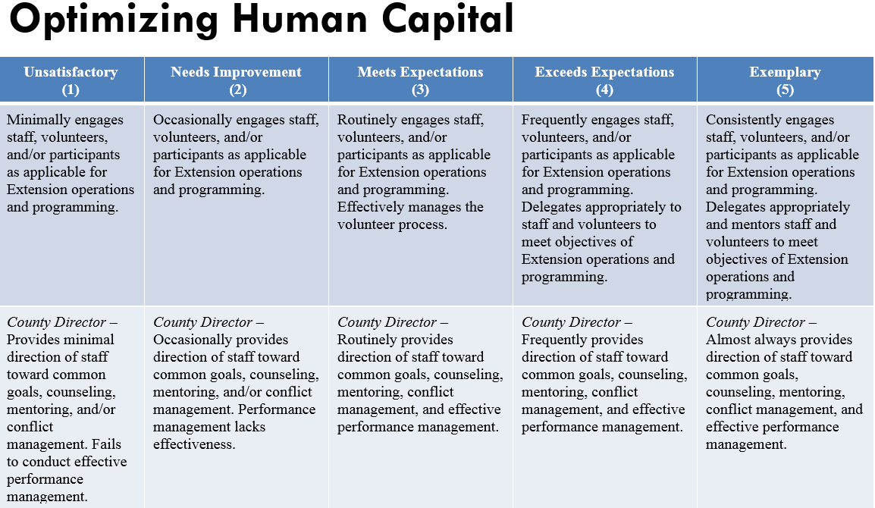
County Director
Notes:
When we look at the descriptions for the role of Extension Agent and County Director, we are considering the entire description. In this example for Optimizing Human Capital, the county director would have to achieve all of the criteria to receive exemplary (5). If any of those descriptions do not represent the county director’s performance, then we would review exceeds expectations (4). If any of those had not been achieved, we would then review the description for meets expectations (3) and so on.
In other words, for Optimizing Human Capital, we are making one rating for the County Director, not one rating for their performance as an agent, and a second rating for their performance as a county director. It should be noted that the formal job title is “Extension Agent and County Director.” We do not have anyone with the title “County Director” but we do use the term “County Director” in conversation and in presentations like this for clarity.

Slide 37
Rating in SUPER
Notes:
This is an example screen shot from SUPER. The performance factors and criteria will be grouped together. In this case, program accomplishments is the performance factor and base programs is the criteria. Notice that the descriptions will be listed. The county director and/or regional director will just click the box, and this example shows Exceeds Expectations (4) is has been marked (it grays out and a check mark is shown). It can be changed just by clicking another level.

Slide 38
Summary and Next Steps
Tennessee Extension Performance Appraisal System
Notes:
Let’s cover the summary and next steps as well as address any questions that you have before we adjourn today.

Slide 39
Group Discussion
What were some of the most important things you learned today?
What do you like about the new appraisal system?
What questions do you have about the new appraisal system?
What aspects of the appraisal manual do you find most helpful?
Notes:
[The next activity may be completed by asking participants to either work with one other person or work in groups of 3-5 depending on the number of participants and the room size.]
The next activity will help us to process today’s workshop. Look at the four questions on the screen. Discuss these questions in your group; there are no right or wrong answers. Now, take the next 15 minutes to talk over these questions in your group.
[After the participants have had time to work in their groups, bring them back together. Process the activity by asking participants to respond.]

Slide 40
Make Plans to Continue Leaning
Complete IAP for 2017
Complete Goals for the Coming Year
Use the manual
Online Resources
Performance appraisal
Notes:
Complete IAP for 2017 – Complete your IAP for 2017. Again, the comments and program development score from the RPL will transfer in SUPER to your 2017 appraisal form.
Complete Goals for the Coming Year – Complete your goals for the coming year. These will transfer in SUPER to your 2017 appraisal form.
Use the Manual – I want emphasize that one of the best things about this revised appraisal system is that it comes with a manual! Please continue to use the manual. It is 57 pages which seems like a lot! It clarifies many things that were ambiguous in all previous appraisal systems. It will provide consistency and fairness across counties and regions in appraisal implementation. Notice on page 6 of the manual, a list of suggestions are made for using the manual:
Schedule time annually for yourself to review the entire manual.
Schedule time at least quarterly for yourself to carefully review the appraisal criteria and consider your work performance, plans, and goals.
Review one section (Introduction, Performance Factors and Criteria, Conducting the Appraisal, Goals, and Assessing Performance) in each weekly office conference five weeks prior to the date appraisals are due to County Directors.
Review the manual prior to and during each step in the appraisal process.
Review the performance factors, criteria, and descriptions. If anything seems confusing, contact your supervisor.
Online Resources – All of the materials, such as the performance factors and criteria, appraisal manual, and white paper have been posted to the performance appraisal page: https://extension.tennessee.edu/eesd/Pages/PerformanceAppraisal.aspx
If there are any updates or additional materials, they will be posted to this page.
[Show the page to participants. Note the materials already posted such as the white paper and manual.]

Slide 41
What questions do you have?
Tennessee Extension Performance Appraisal System
Notes:
[Answer participant questions. If possible, have your manual handy and reference the page number. If you need to confirm an answer, explain that you will capture the question and submit to Shirley Hastings and Beth Duncan. Write the question on the “Questions” flip chart. Send the questions to Shirley and Beth. After the workshops are conducted, they will share answers with all of the regional directors for distribution to all personnel in the region. These questions are important as they may be used to revise the Appraisal Manual.]

Slide 42
Have a safe trip home!
Tennessee Extension Performance Appraisal System
Notes:
Our workshop is adjourned. Have a safe trip home!

