Slide 1
Career Development in
TENNESSEE EXTENSION

Slide 2
CAREER DEVELOPMENT
Becoming a Leader in Tennessee Extension
Setting Yourself Up for Success
Building Your Extension Career

Slide 3
CAREER DEVELOPMENT
Build Your Professional Reputation
Develop Your Skills and Expertise
Build Your Network
Seek Out Challenges and Opportunities

Slide 4
SETTING YOURSELF UP FOR SUCCESS IN YOUR
EXTENSION CAREER

Slide 5
Setting Yourself Up for Success in
YOUR EXTENSION CAREER
Mentoring
Tuition Benefits
Professional Development
Promotion Process

Slide 6
Prepare for meetings with your assigned mentor.
Honor the time commitment.
Let them know how they can best help you.
Ask questions!
Ask them to help you get connected.
Be curious and teachable.
Build a network of unofficial mentors.
Ask your mentor, RPL, County Director, etc. to recommend others you can connect with.
Look for ways to collaborate with your mentor(s).
Getting the most out of the
MENTORING EXPERIENCE

Slide 7
Setting Yourself Up for Success in
YOUR EXTENSION CAREER
Mentoring
Tuition Benefits
Professional Development
Promotion Process

Slide 8
Using Your Tuition Benefits
Your tuition benefits cover up to 9 hours per semester at UT system schools.
You can pursue any degree: Associates, Bachelors, Masters, or Doctorate.
Furthering Your Education for Advancement Opportunities
Promotion track
Raises
Preparing for other Extension roles
Degree requirements for different roles
Selecting a program
https://hr.utk.edu/self-care/educationalassistance/
Using Your Tuition Benefits for
FURTHERING EDUCATION

Slide 9
Going to School while Working Full Time
Scheduling and workload
Ensuring Extension programs are covered
Work life balance
Student support services
Using Your Tuition Benefits for
FURTHERING EDUCATION
Notes:
https://hr.utk.edu/self-care/educationalassistance/

Slide 10
Setting Yourself Up for Success in
YOUR EXTENSION CAREER
Mentoring
Tuition Benefits
Professional Development
Promotion Process

Slide 11
Soft Skills for Success in Extension
Communication & Interpersonal Skills
Written communication
Verbal communication
Emotional intelligence
Respect and tact
Conflict resolution
Professionalism
Ethical and honest behavior
Business etiquette
Professional appearance
Time and resource management
Reliability
Lifelong learning
Leadership
Teamwork
Inclusivity
Delegation
Giving and receiving feedback
Taking Advantage of
PROFESSIONAL DEVELOPMENT

Slide 12
Extension Professional Development
FranklinCovey Offerings
The 7 Habits of Highly Effective People workshop
The Speed of Trust workshop
Online Learning in K@TE
Hundreds of self-paced online learning courses
UT Employee & Organizational Development Certificate Programs
Blended learning certificates - Zoom and learning modules
Self-paced online certificates
Taking Advantage of
PROFESSIONAL DEVELOPMENT

Slide 13
UT Professional Development
Everything offered by UTK is available to Extension employees!
Opportunities are available through Learning and Organizational Development (UTK) and Employee and Organizational Development (UT System).
EOD Conferences
Conference for Women's Leadership
BEST Man Forum
NEXT Conference
Administrative Professionals Summit
Office of Ombuds Services
Conflict resolution training
Taking Advantage of
PROFESSIONAL DEVELOPMENT

Slide 14
Setting Yourself Up for Success in
YOUR EXTENSION CAREER
Mentoring
Tuition Benefits
Professional Development
Promotion Process

Slide 15
Promotion Process and Timeline
Preparing for
Start Preparing Now
Keep your SUPER profile up to date.
Write quality impact statements.
Dossier process
https://eesd.tennessee.edu/human-resources/performance-promotion/
PROMOTION

Slide 16
BUILDING YOUR
EXTENSION CAREER

Slide 17
Building
YOUR EXTENSION CAREER
Networking
Getting Involved
Awards
Sharing Your Work

Slide 18
Value of Networking
Building meaningful connections with other Extension professionals across the state leads to:
Idea sharing and learning from others
Creative problem solving
Collaboration on programs and projects
Expanded understanding and view of the organization
Innovation and interdisciplinary programs
Increased professional confidence
Supportive network to ask questions and share resources and information
NETWORKING

Slide 19
Networking Tips
Introduce yourself to at least one person you don't know at every event you attend.
Be intentional to build quality relationships over time.
Be curious and ask questions. Have some go-to questions that you can fall back on.
Practice active listening.
Build informal connections through meals and social outings.
NETWORKING

Slide 20
Building
YOUR EXTENSION CAREER
Networking
Getting Involved
Awards
Sharing Your Work

Slide 21
Benefits of Getting Involved
Build your professional reputation.
Build a support network and expand your network statewide.
Use your passions and interests to contribute.
Gain a broader view of the organization.
GETTING INVOLVED

Slide 22
PROFESSIONAL ASSOCIATIONS
BENEFITS
Fellowship &
Networking
Professional Development
National & State Conferences
Awards & Recognition
Leadership Opportunities

Slide 23
TENNESSEE EXTENSION PROFESSIONAL ASSOCIATIONS
TEAFCS
Tennessee Extension Association of Family & Consumer Sciences
TAAA&S
Tennessee Association of Agriculture Agents & Specialists
TAE4-HW
Tennessee Association of
4-H Workers
TEAAP
Tennessee Extension Association of Administrative Professionals
ESP
Epsilon Sigma Phi
Omega Chapter
BEP
Black Extension Professionals

Slide 24
Join a Professional Association
Join Statewide Committees and Workgroups
Join National Committees and Groups
GETTING INVOLVED

Slide 25
Building
YOUR EXTENSION CAREER
Networking
Getting Involved
Awards
Sharing Your Work

Slide 26
Finding and Applying for Awards
AWARDS

Slide 27
Examples
Professional Development
New Worker
Leadership
Achievement/Accomplishment
Program Area
Faculty
Non-Exempt
AWARDS

Slide 28
Building
YOUR EXTENSION CAREER
Networking
Getting Involved
Awards
Sharing Your Work

Slide 29
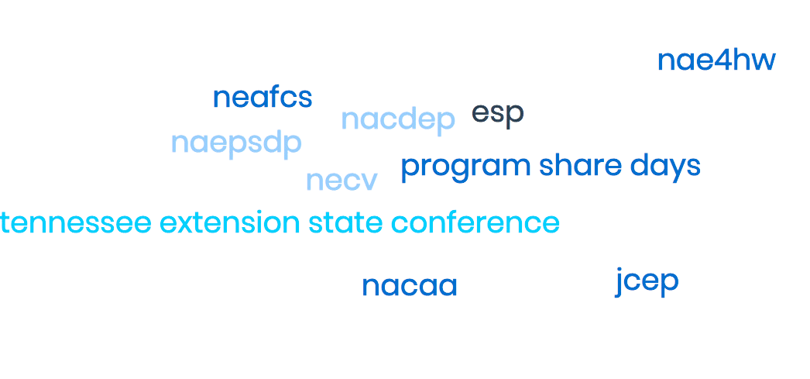
Present Your Work at Regional, State, and National Meetings
Extension Publications
SHARING
YOUR WORK

Slide 30
Publishing in the
Journal of Extension
joe.org
JOE is the flagship refereed journal of Extension professionals.
Publish original and applied research findings and share successful educational applications, scholarly opinions, educational resources, and challenges on issues of critical importance to Extension educators.
Yes, you can publish! The Journal of Extension is committed to developing new authors!
Article categories
Research in Brief
Tools of the Trade
Feature Articles
Ideas at Work
SHARING
YOUR WORK

Slide 31
LOOKING AHEAD:
BECOMING A LEADER
IN TENNESSEE EXTENSION

Slide 32
Becoming a Leader in
TENNESSEE EXTENSION
Become a Mentor
Association Leadership Positions
Committee/ Workgroup Leadership
Tennessee Extension Leadership Academy

Slide 33
Become a Mentor to a New Employee - 3 years
Mentoring Interns
Unofficial Mentoring
BECOME A MENTOR

Slide 34
Becoming a Leader in
TENNESSEE EXTENSION
Become a Mentor
Association Leadership Positions
Committee/ Workgroup Leadership
Tennessee Extension Leadership Academy

Slide 35
Association Leadership
Officer Positions
Sub committees
ASSOCIATION LEADERSHIP POSITIONS

Slide 36
Becoming a Leader in
TENNESSEE EXTENSION
Become a Mentor
Association Leadership Positions
Committee/ Workgroup Leadership
Tennessee Extension Leadership Academy

Slide 37
Committee and Workgroup Leadership
ANR leadership team Focus Areas
FCS Committees
4-H Committees
COMMITTEE AND WORKGROUP LEADERSHIP
Notes:
ANR
Consumer Horticulture or any listed under the Livestock and Forges Leadership Team (Beef, Small Ruminant, Dairy).
FCS
Family and Consumer Economics Leadership Teams – Community Health, Consumer Economics, Human Development, and Nutrition and Food Safety
Family and Consumer Economics Leadership Team Retreat
Family and Consumer Economics Professional Development Planning Committee
Regional Family and Community Education Leadership Teams
4-H
4-H Camp Steering Committee
4-H Outreach and Engagement Committee
STEM Steering Committee

Slide 38
Becoming a Leader in
TENNESSEE EXTENSION
Become a Mentor
Association Leadership Positions
Committee/ Workgroup Leadership
Tennessee Extension Leadership Academy

Slide 39
TELA
Open to all employees with at least 3 years of experience.
Session Topics:
Discovering You and Leading Yourself
Leading Others
Leading within the Organization
Leadership Project Showcase and Graduation
TENNESSEE EXTENSION LEADERSHIP ACADEMY

Slide 40
PANEL DISCUSSION

