Slide 1
Family and Consumer Sciences / Cooperative Extension

Slide 2
Family and Consumer Sciences / Cooperative Extension
We offer practical and useful research-based programs, resources, and publications in:
Agriculture and natural resource,
Family and consumer sciences,
4-H youth development,
Community resources and economic development.
Specialists and county extension agents conduct:
Education sessions,
Conferences,
Workshops to address community needs.

Slide 3
Who we are
Extension Faculty
Extension Agents

Slide 4
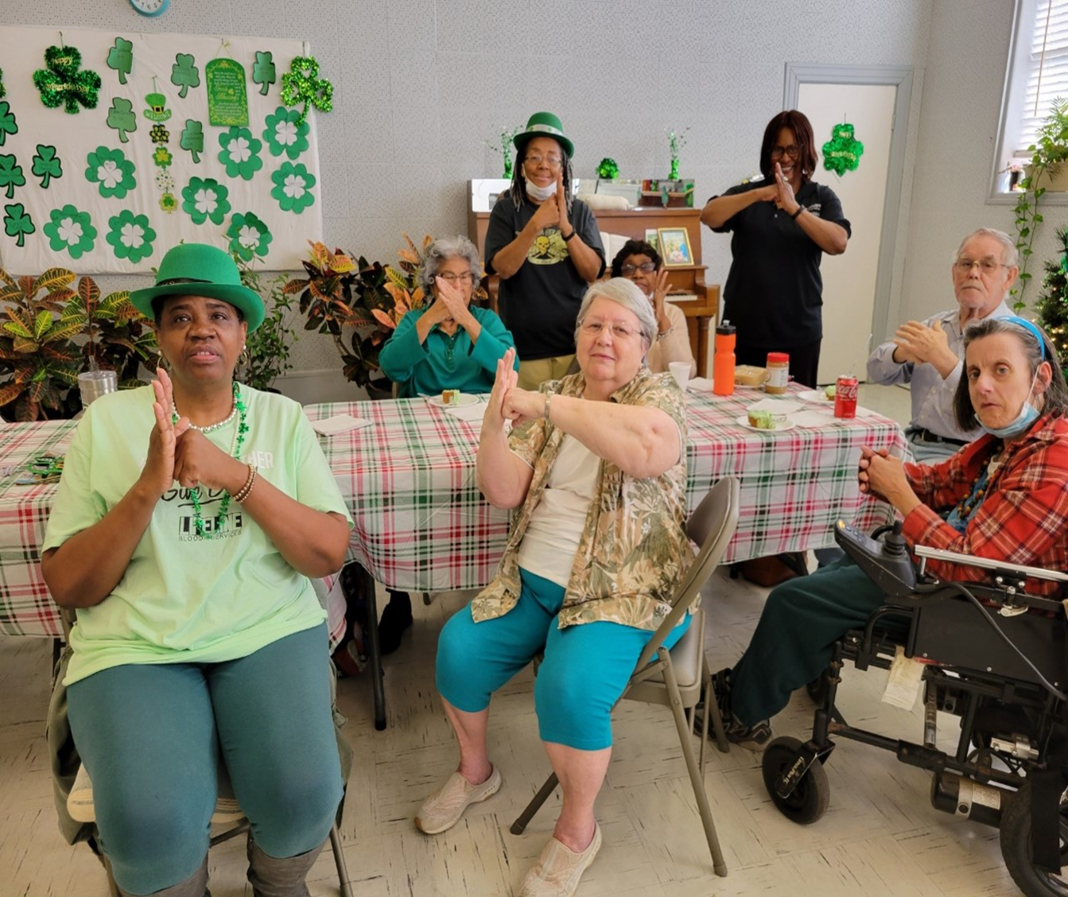
Program Focuses
Parenting
Grandparents and Relative Caregivers
Nutrition Education and Food Safety
Health Education
Child Development
Gerontology
Emergency Preparedness

Slide 5
Tai Chi for Seniors

Slide 6
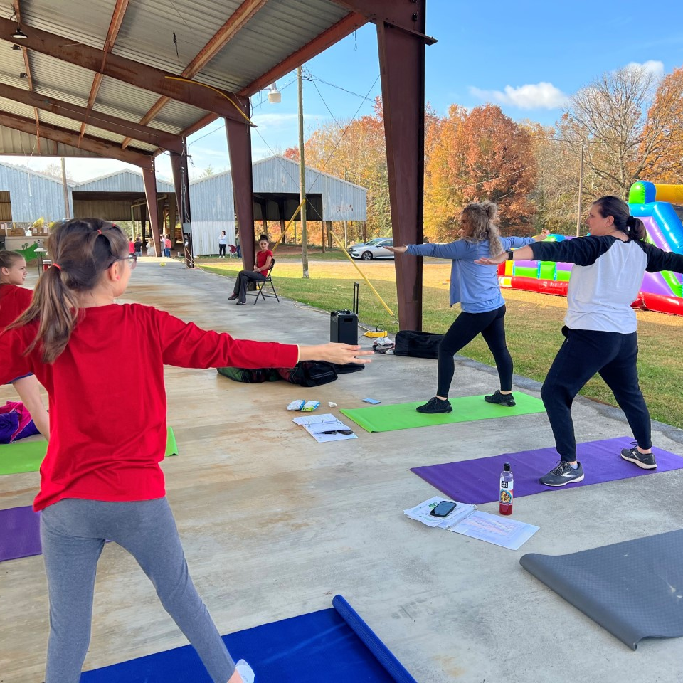
Kids Tai Chi

Slide 7
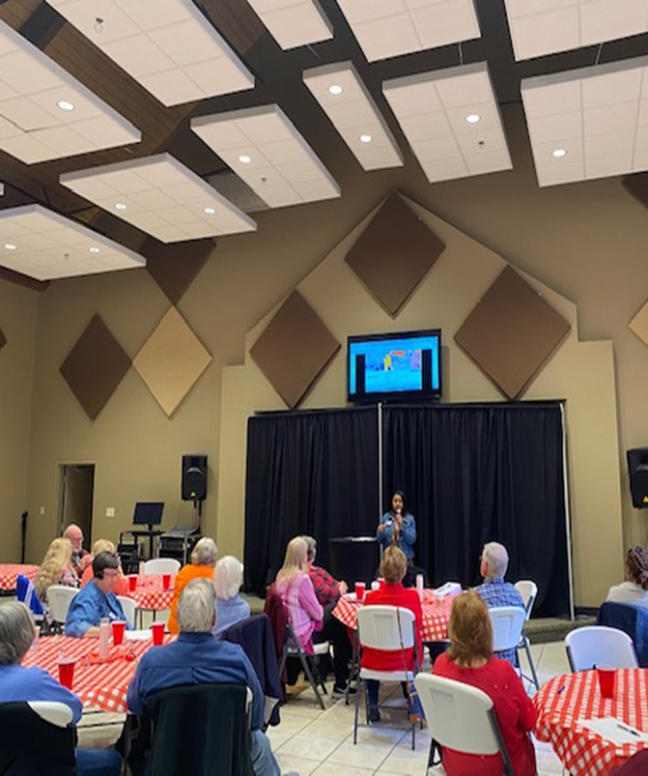
Living Well with Chronic Diseases

Slide 8
Homebuyer Education Program

Slide 9
Signature Programs & Impact Statements
Vaccine with Confidence
Homebuyers Education
Living Well with Chronic Diseases
"The education helped in making my decision to get vaccinated to protect me and my family"
“I thought the course was great! It was helpful and we learned a lot. I am glad we took it even if our loan might not require it.”
“Misty and Shay were awesome! I wish more people would have come. I learned so much and was even able to laugh about a sobering topic.“

Slide 10
Economic Outcomes
HUMAN DEVELOPMENT AND STRENGTHENING FAMILIES
Own my Own and Homebuyers Education Workshops
These initiatives were estimated to contribute more than $50.59 million in economic benefits to individuals and families.
COMMUNITY HEALTH INITIATIVES
EXCITE “ The Return and Living Well with Chronic Conditions
These initiatives was estimated at saving residents more than $354,789 in estimated direct medical costs and indirect expenditures.

Slide 11
Contact Information
Rita Fleming
rfleming2@tnstate.edu

