Slide 1
WELCOME!!!
Laura Clark, M.S.
FCS Extension Specialist

Slide 2
STARTING OFF STRONG!
Laura Clark, M.S.
FCS Extension Specialist

Slide 3
SETTLE IN!
Make your space your own!

Slide 4
GET TO KNOW YOUR COWORKERS!
Make personal and professional connections.

Slide 5
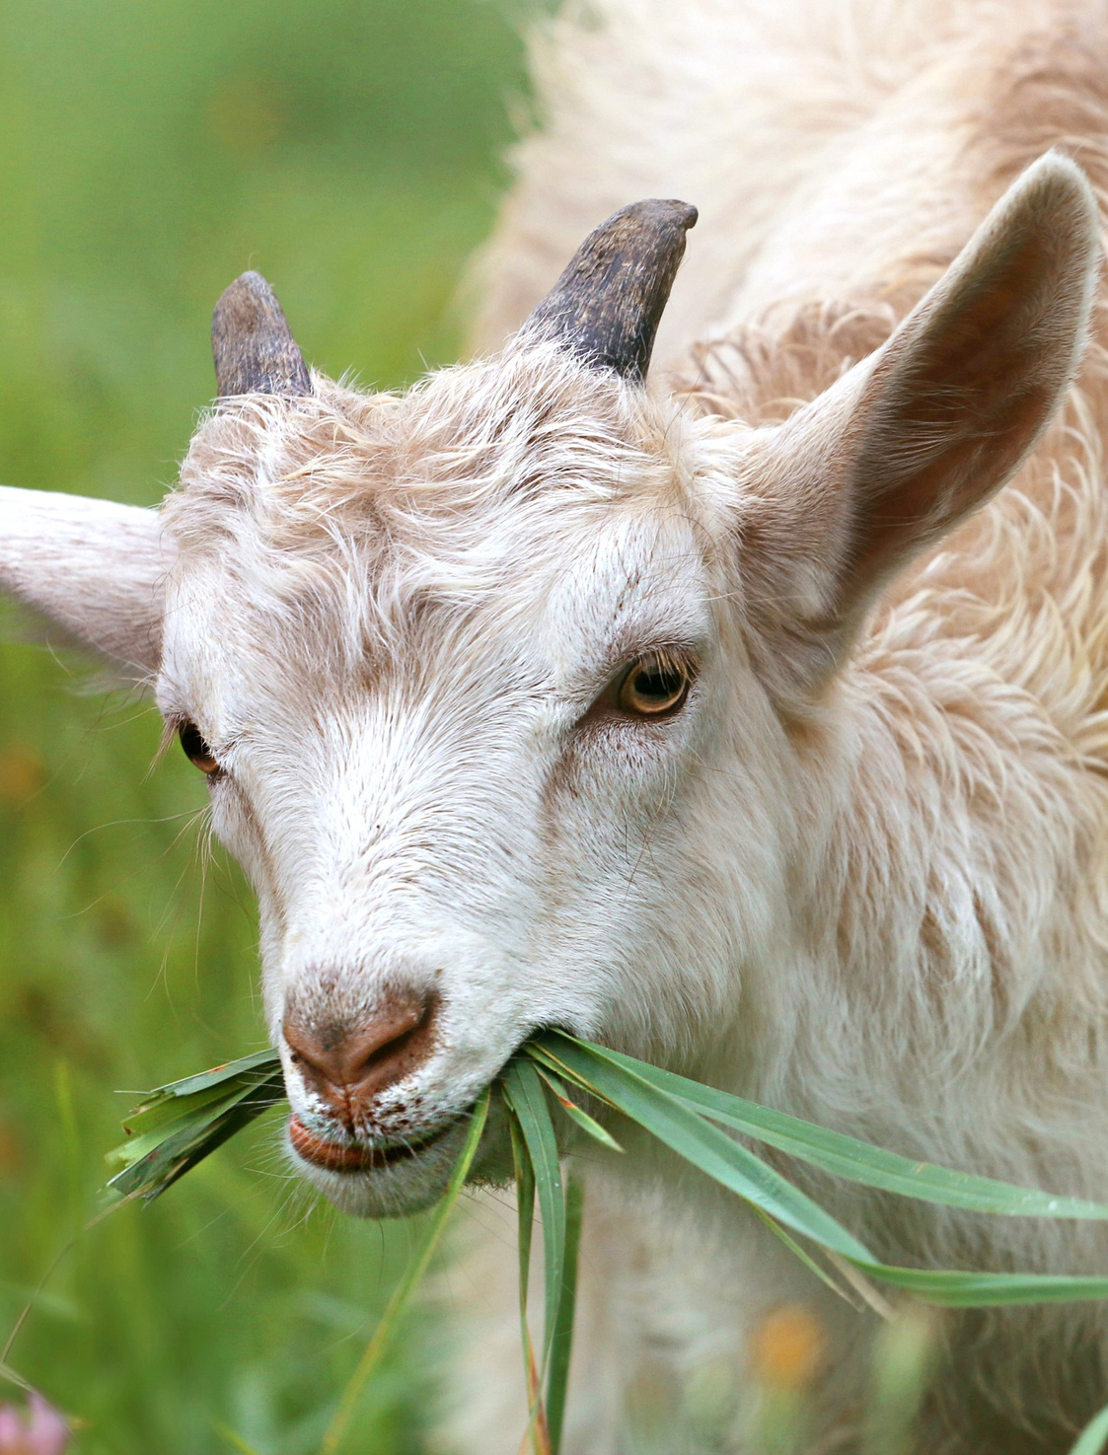
GET TO KNOW YOUR EXTENSION OFFICE
What programs are being offered in the community? What makes your office great?

Slide 6
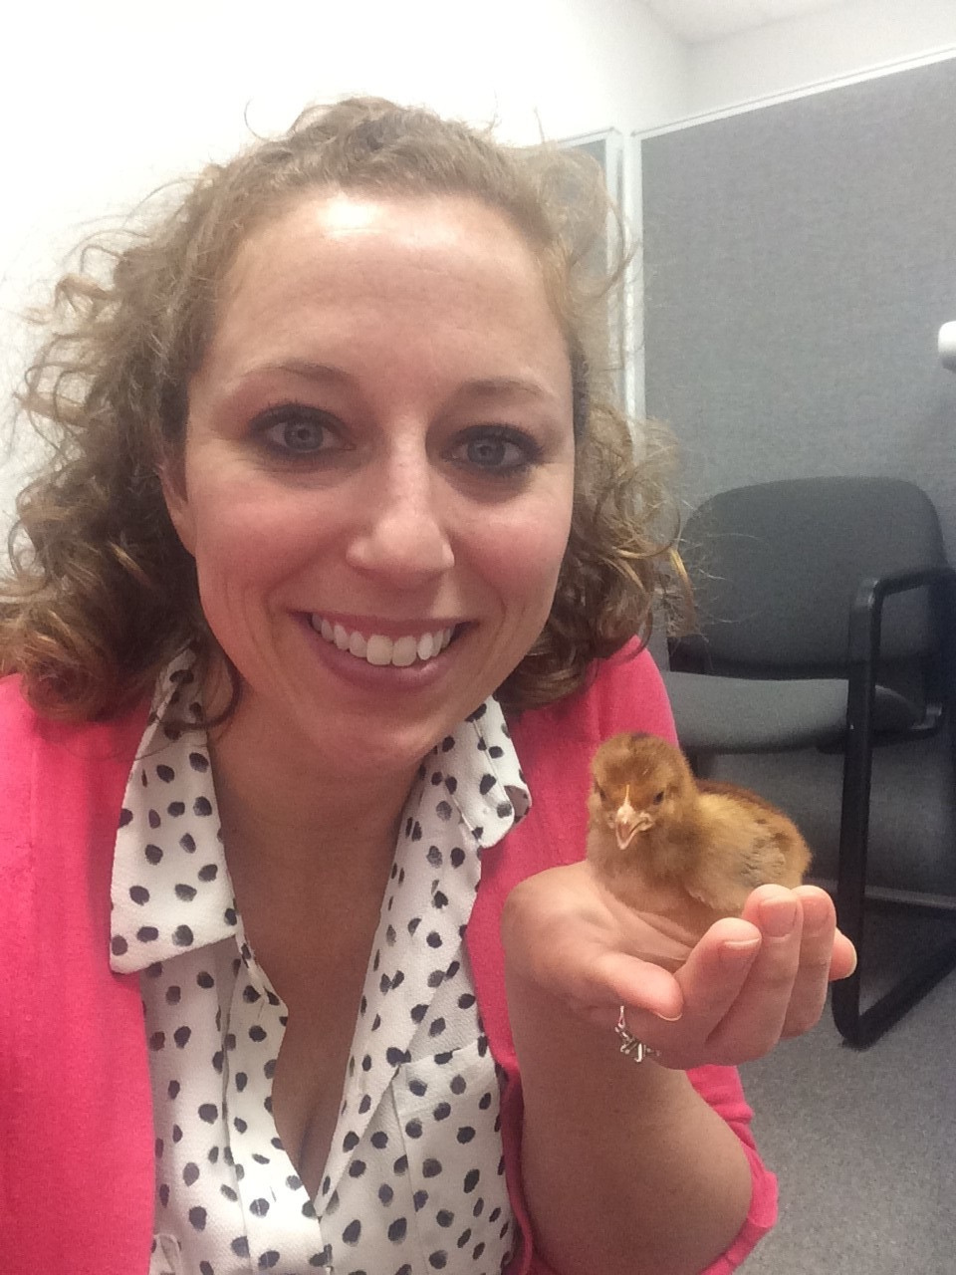
PITCH IN!
Help your coworkers especially while you are learning and have extra time.

Slide 7
GET TO KNOW YOUR COUNTY
What resources exist in your county?

Slide 8
GET TO KNOW YOUR COUNTY
Who is already doing what?

Slide 9
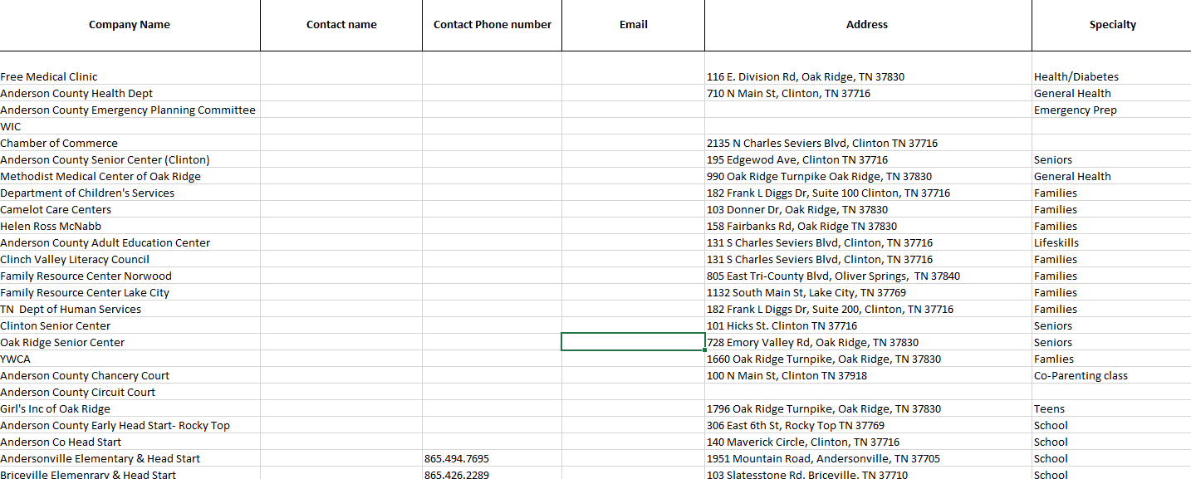

Slide 10
GET TO KNOW YOUR COUNTY
What does your county need?

Slide 11
GET TO KNOW YOUR COUNTY
What gaps can you fill?

Slide 12
NETWORK!
Attend events, go to meetings in person, get to there early, or stay a little longer and chat.

Slide 13
Spend time with the Internal Resources site!
Take the time and explore the programs, what is on the site and who you might need to contact.

Slide 14
Learn Canva!
It will be your best friend!
Don’t pay for it! We get it for free!
https://www.canva.com/education/
Click on “Teachers- Get Verified”

Slide 15
BUILD PARTNERSHIPS
Give and take!

Slide 16
WHY BUILD PARTNERSHIPS?

Slide 17
SAY 'YES!'
If someone asks you to do something,
make it happen!

Slide 18
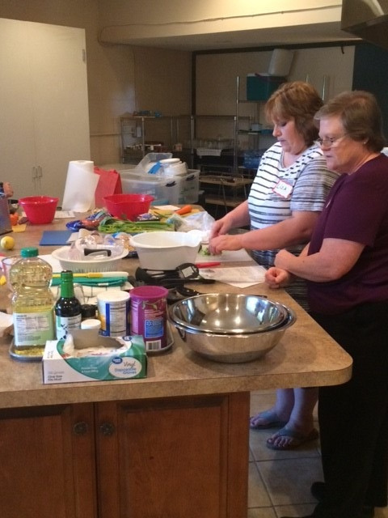
OBSERVE OTHERS!
Try to shadow seasoned agents nearby.

Slide 19
ASK QUESTIONS!
Every office operates differently.

Slide 20
SET SOME GOALS!
Daily? Weekly? Monthly?

Slide 21
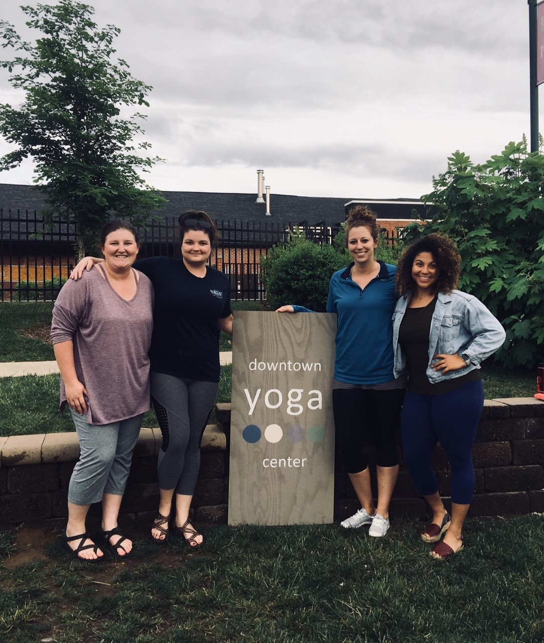
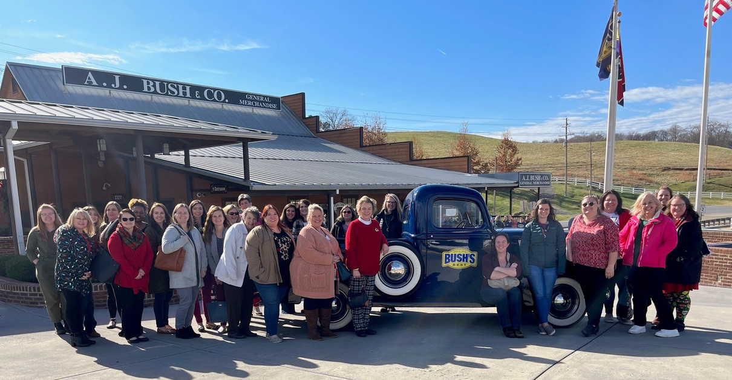
GET AND STAY CONNECTED!
Join TEAFCS! Meet other agents!

Slide 22
WHAT HAVE YOU DONE
THAT HAS BEEN HELPFUL IN YOUR COUNTY?

Slide 23
Questions?

Slide 24
Closing Activity

Slide 25
How did you end up working for Extension?

Slide 26
Talk about a mentor or someone who played a pivotal role in who you are today.

Slide 27
What is one success that you have had so far?

Slide 28
What has been your biggest challenge so far?

