Slide 1
4-H and Youth Development

Slide 2
Tennessee 4-H Mission
The mission of Tennessee 4-H is to provide research-based Extension educational experiences that will stimulate young people to gain knowledge, develop life skills, and form positive attitudes to prepare them to become capable, responsible and compassionate adults.

Slide 3
Tennessee 4-H History
Tomato and canning clubs for girls
Formed the basis for youth “home economics”
Corn clubs for boys
Formed the basis for youth “agriculture”

Slide 4
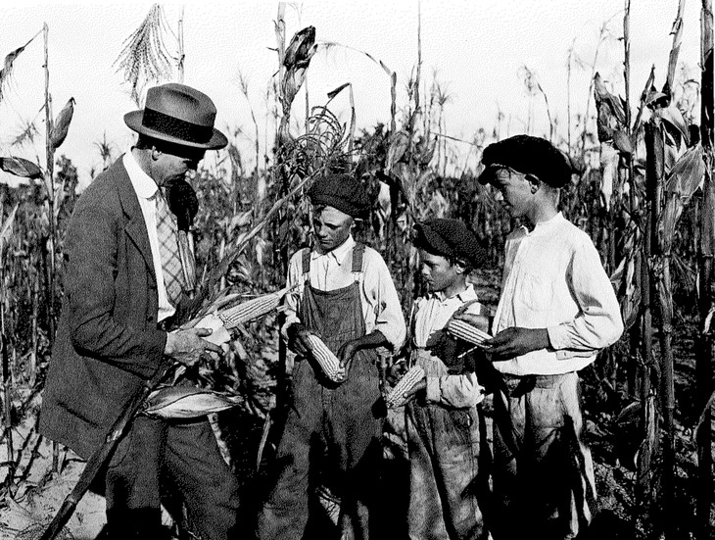

Slide 5
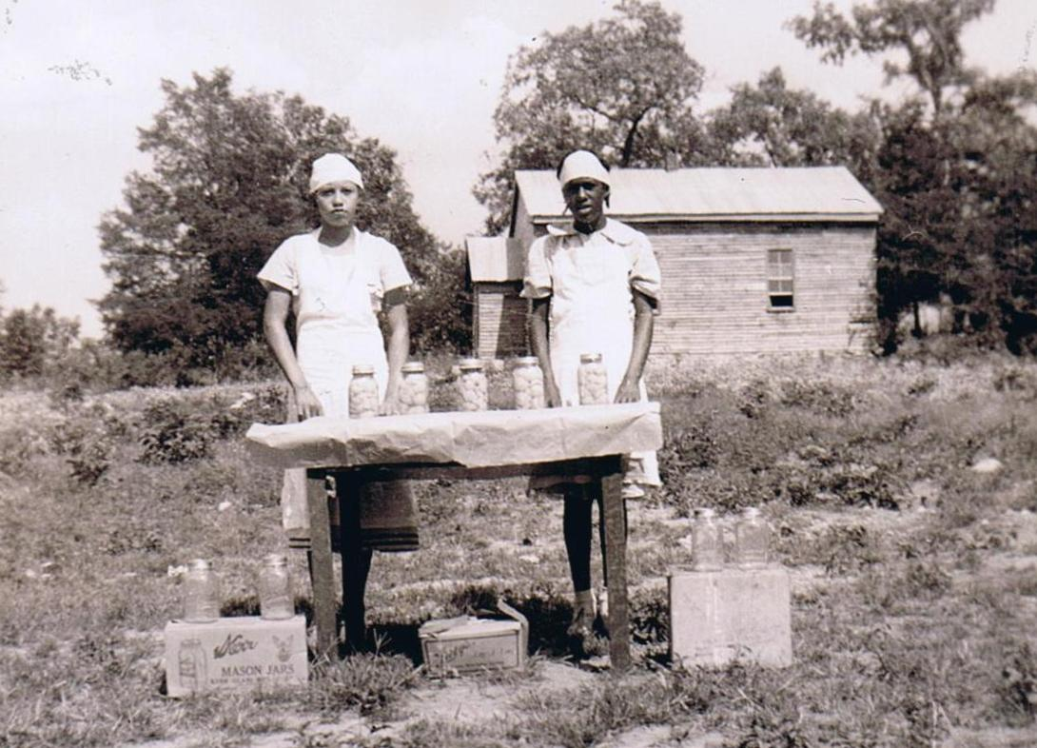

Slide 6
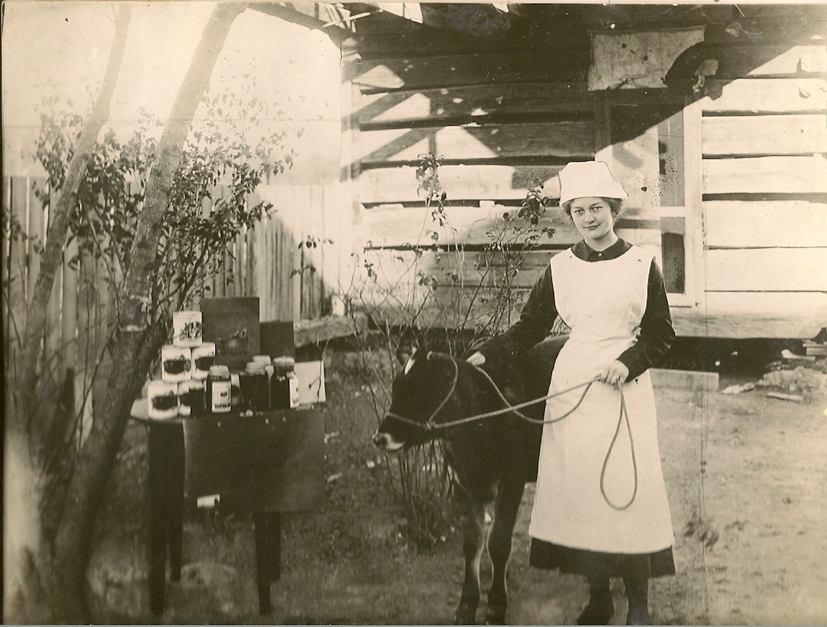

Slide 7
A glimpse into the present…..

Slide 8
+
=

Slide 9
Highlights
Strong county-based program
Primarily school based
Project focused
Agent/volunteer driven
Largest 4-H “club” program in the country

Slide 10
Audiences
Explorer (4th grade)
Junior (5th grade)
Jr. High (6th – 8th grade)
Sr. High (9th – 12th grade)
Collegiate 4-H

Slide 11
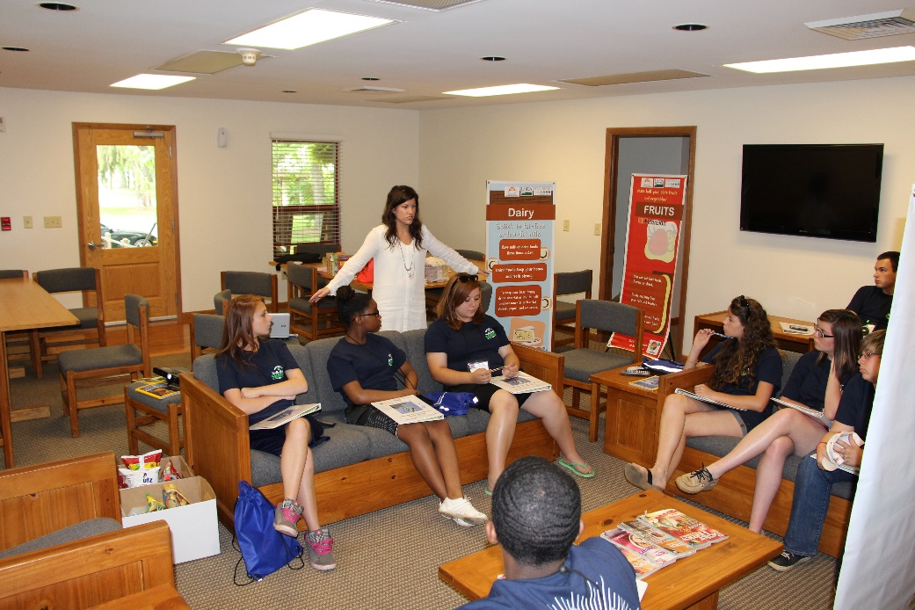
Delivery Methods
Project Groups
Camping
Educational Events
Local, county, regional, state, national, and global
In-School Clubs
Afterschool Clubs
Community Clubs

Slide 12
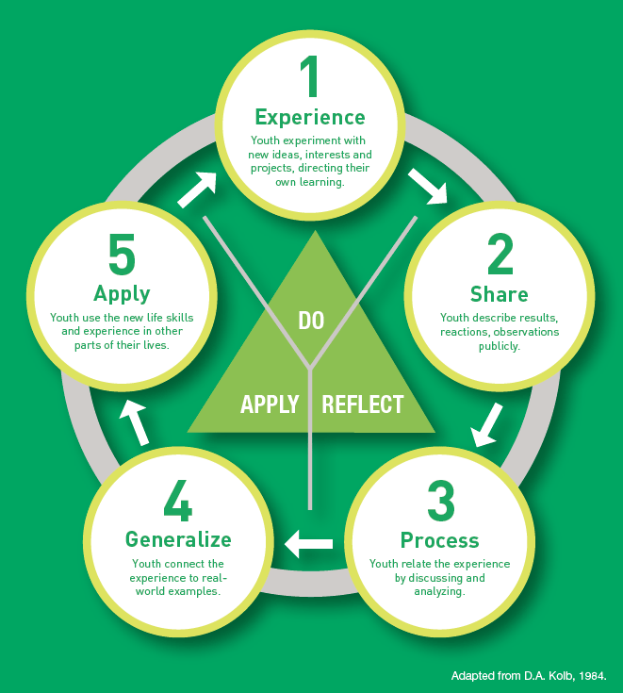
Learning and growing
Experiential Learning Model
4-H Motto: To Make the Best Better
4-H Slogan: Learn by Doing

Slide 13
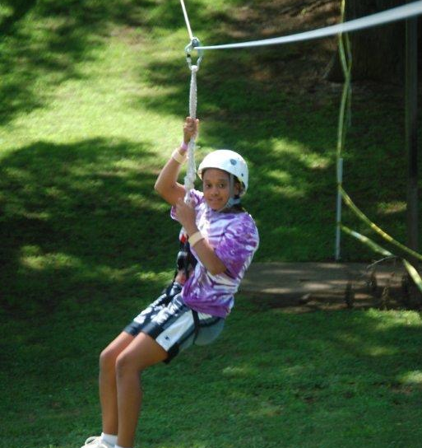
Camping program
Lone Oaks 4-H Center
W.P. Ridley 4-H Center
Clyde M. York 4-H Center
Clyde Austin 4-H Center

Slide 14
Tennessee 4-H
Over 136,000 youth engaged in 4-H educational programs in 95 counties
UT/TSU Extension has a minimum of one 4-H agent in each county

Slide 15
Meet our staff

Slide 16
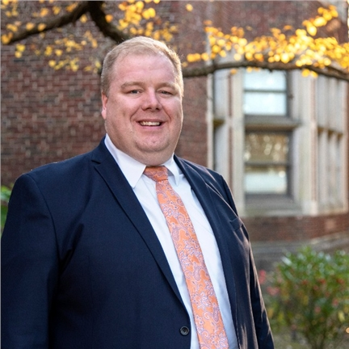
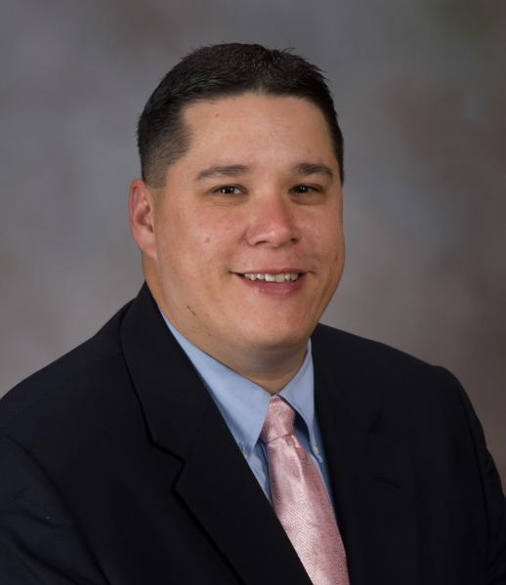
Administration
Justin Crowe
Director/State 4-H Program Leader
University of Tennessee
Tom Broyles
Program Leader, 4-H Tennessee State University

Slide 17
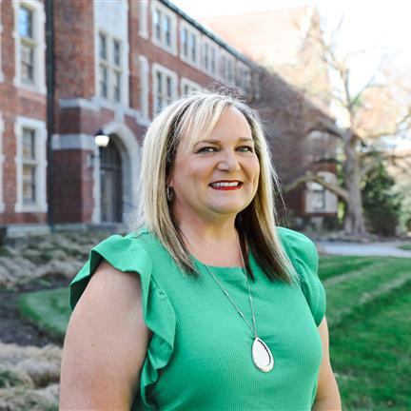
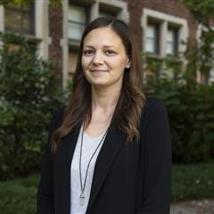
State 4-H Staff
Lori Blanchard
Extension Assistant Next Chapter/Workforce Preparation
Ashley Briggs
Business Manager

Slide 18
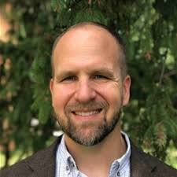
State 4-H Staff
Daniel Collins
Extension Specialist
STEM and Camping
Aaron Fisher
Extension Specialist (Animal Science)
Youth Livestock Programs

Slide 19
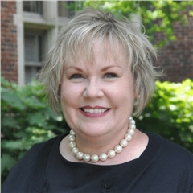
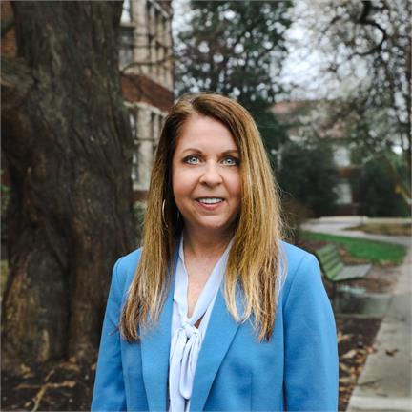
State 4-H Staff
Lori Gallimore
Extension Specialist Awards/Recognition and
Professional Development
Jamie Harris Assistant State 4-H Leader
Extension Specialist
Citizenship, Leadership, International & Teen Programs

Slide 20
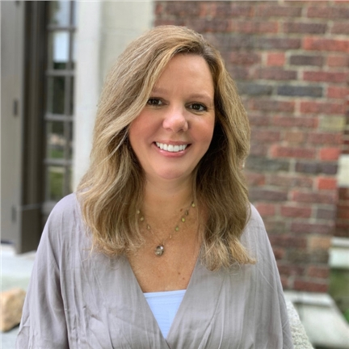
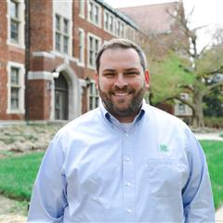
State 4-H Staff
Christie Henderson
Extension Assistant Event Coordination/Donor Relations
Ryan Hensley
Associate Director of Development
4-H Foundation

Slide 21
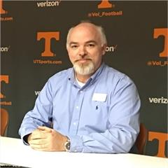
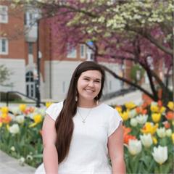
State 4-H Staff
Morris Long
4-H Energy Education Specialist
Celina Menard
4-H Communications Specialist

Slide 22
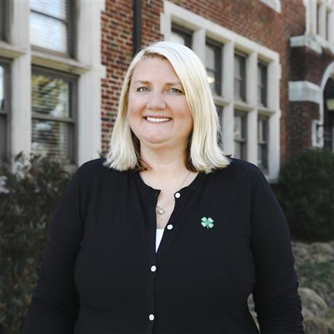
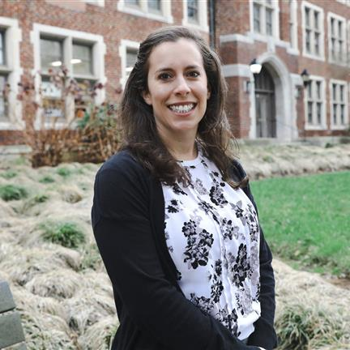
State 4-H Staff
Lynne Middleton
Interim Curriculum Specialist
Erin Ortiz
Extension Specialist
Healthy Living

Slide 23
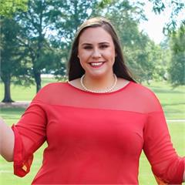
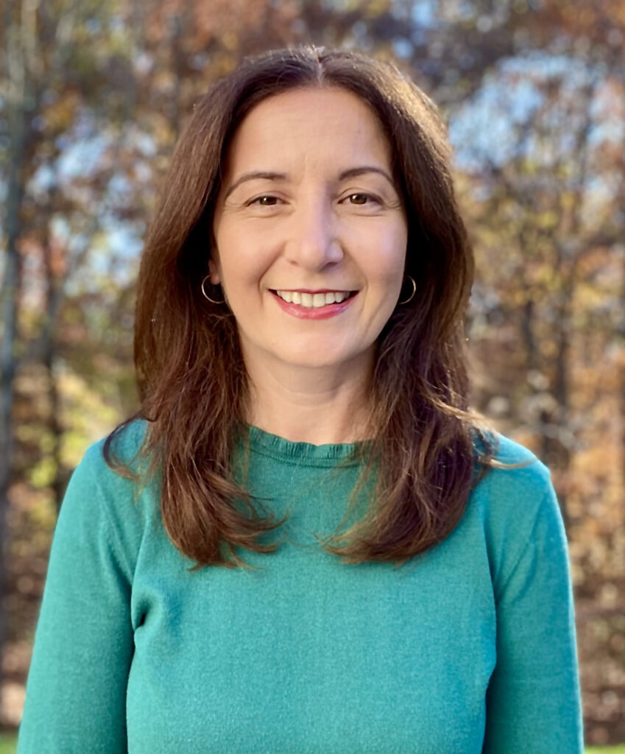
State 4-H Staff
Janiece Pigg
DEI Coordinator
Maya Plaster
Assistant Director
4-H Foundation

Slide 24
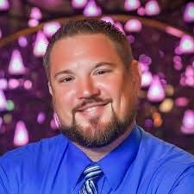
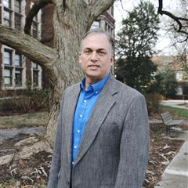
State 4-H Staff
Aaron Spurling
Extension Specialist
Shooting Sports
Daniel Sarver
Extension Specialist
Volunteerism/Data Management

Slide 25
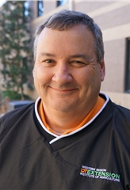
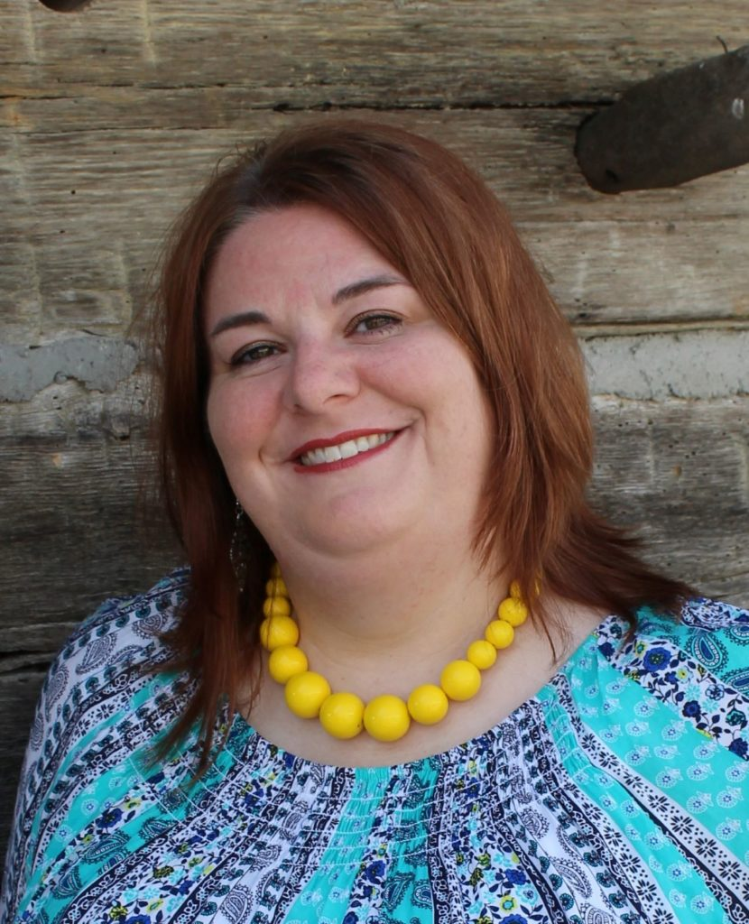
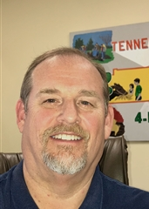
Regional Staff
Neal Smith
Regional 4-H PL
Western Region
Melissa Henry
Regional 4-H PL
Central Region
Mitch Beaty
Regional 4-H PL
Eastern Region

Slide 26
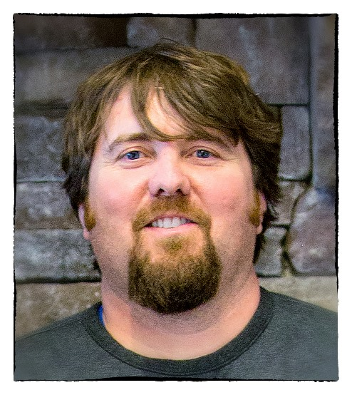
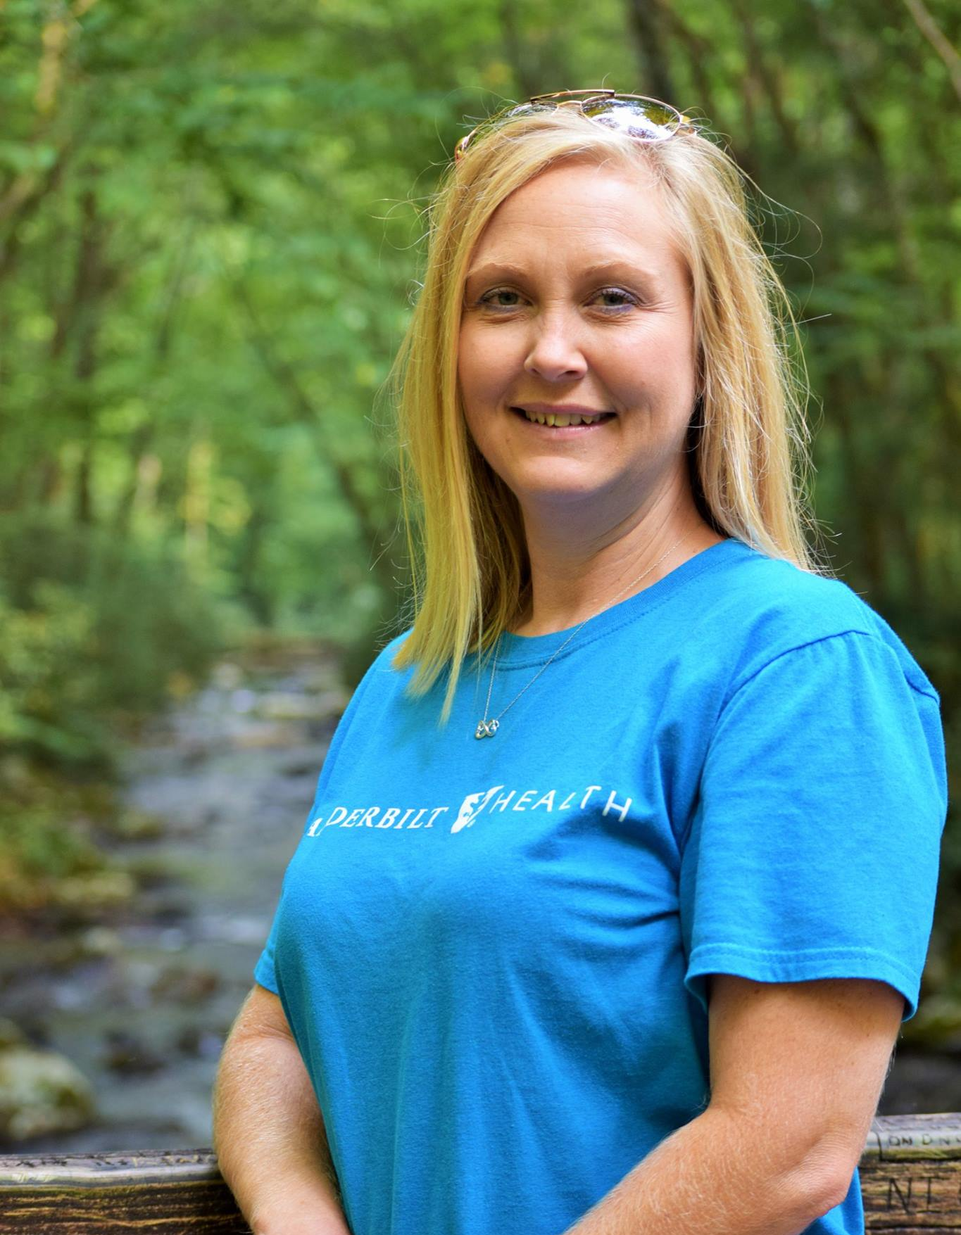
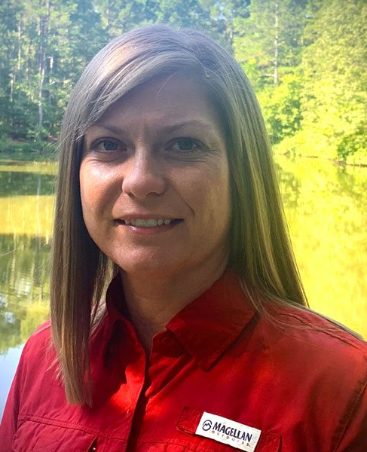
4-H Center Managers
W.P
Terri Quillin
Director
W.P. Ridley 4-H Center
Lacy Harnage
Director
Clyde York 4-H Center
Scottie Fillers
Director
Clyde Austin 4-H Center
Penny Russell
Director
Lone Oaks 4-H Center

Slide 27
Latest and Greatest

Slide 28
4-H Enrollment is on the rise
136,108
Youth Enrolled
4,908
In-School 4-H Clubs

Slide 29
2 New Project Areas
Outdoor Recreation and Shooting Sports
Entrepreneurship
29 Total Project Areas

Slide 30
11 Projects to Earn Course Credit

Slide 31
Grant Funding for Counties
$408,000

Slide 32
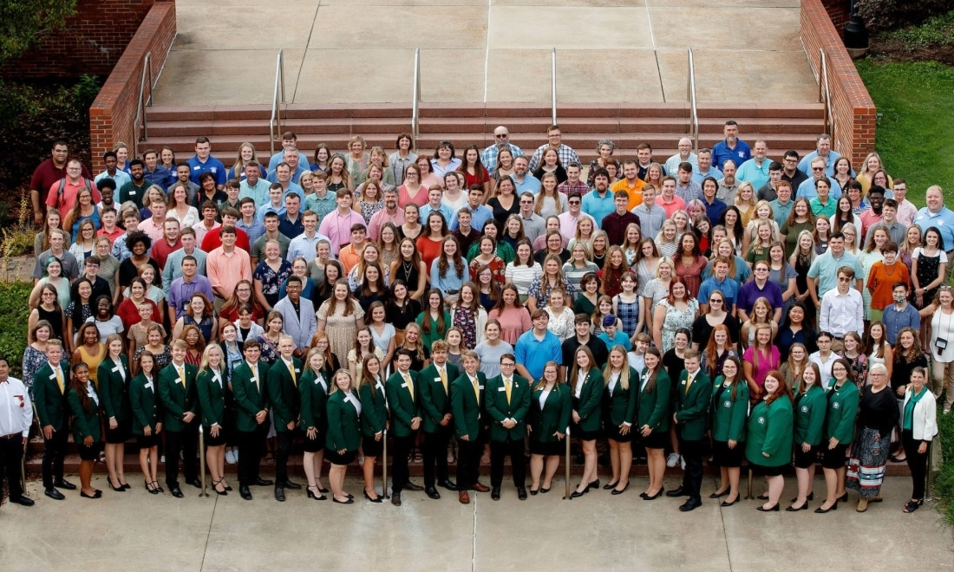
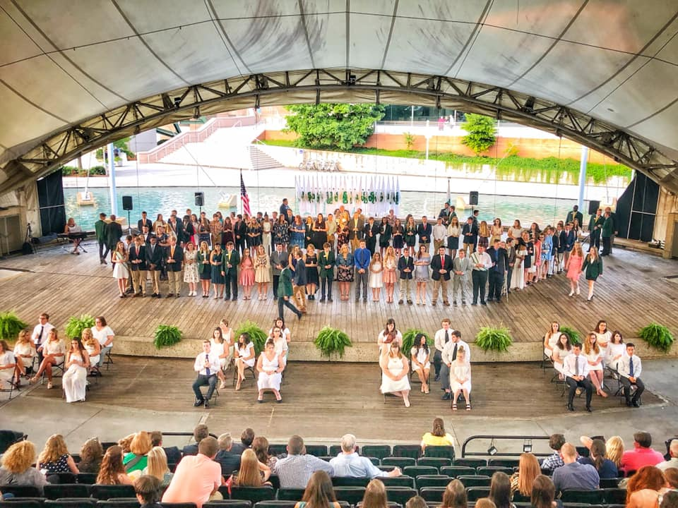
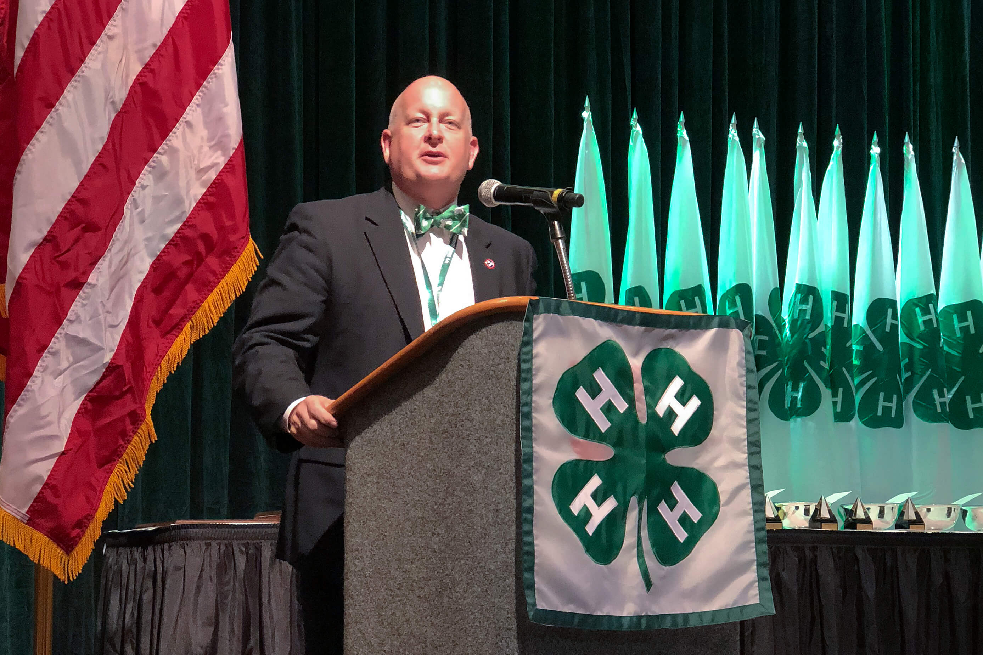
100th 4-H Roundup - 2023

Slide 33
4-H Strategic Plan

Slide 34
4-H Strategic Plan
Accelerate efforts to increase youth engagement.
Establish a sustainable culture of volunteerism in every
county.
Enhance brand relevance and expand outreach.
Implement fun, safe, and dynamic educational camping
experiences.
Strengthen collaboration and broaden partnerships with
internal and external audiences.

Slide 35
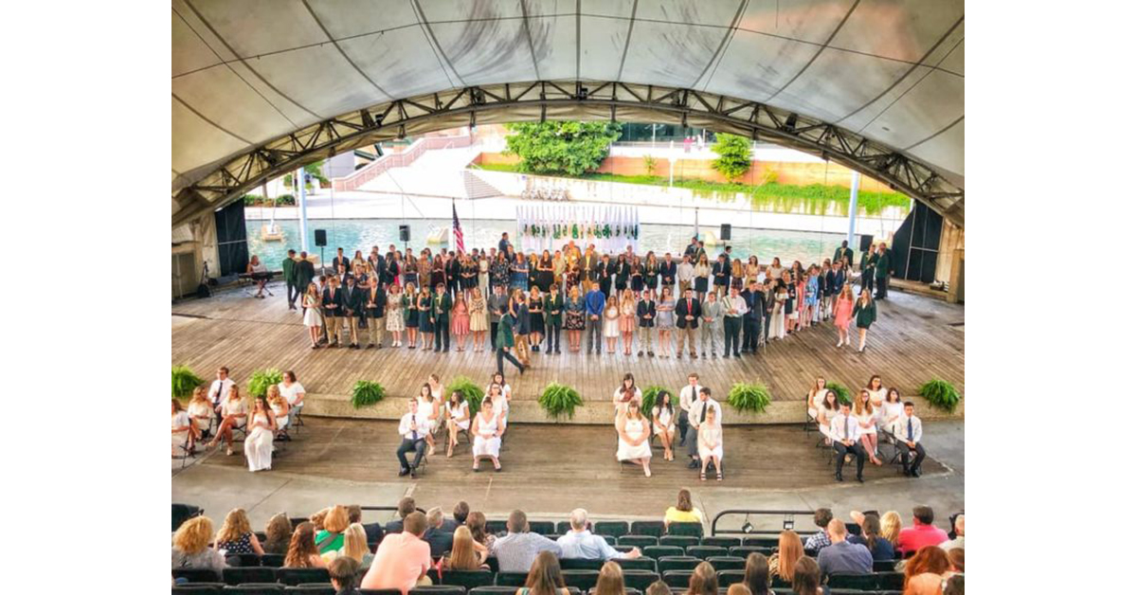
Rotations
Animal Science – Aaron
College and Career Preparation – Lori
Communications - Celina
Healthy Living - Erin
Teen Leadership, Citizenship, and International Programs – Jamie
Volunteerism - Daniel

Slide 36
Questions?

