Slide 1
Work/Life
Balance
Laura Clark
Extension Specialist

Slide 2
What is
Work/Life Balance?

Slide 3
What is Work/Life Balance?
It is different for everyone!

Slide 4
What is Work/Life Balance?
“equal time or priority to personal and professional activities.”
Not Realistic!

Slide 5
Any Better?
Work/Life Integration
Work/Life Blending

Slide 6
My Definition
"When I don't work too much."

Slide 7
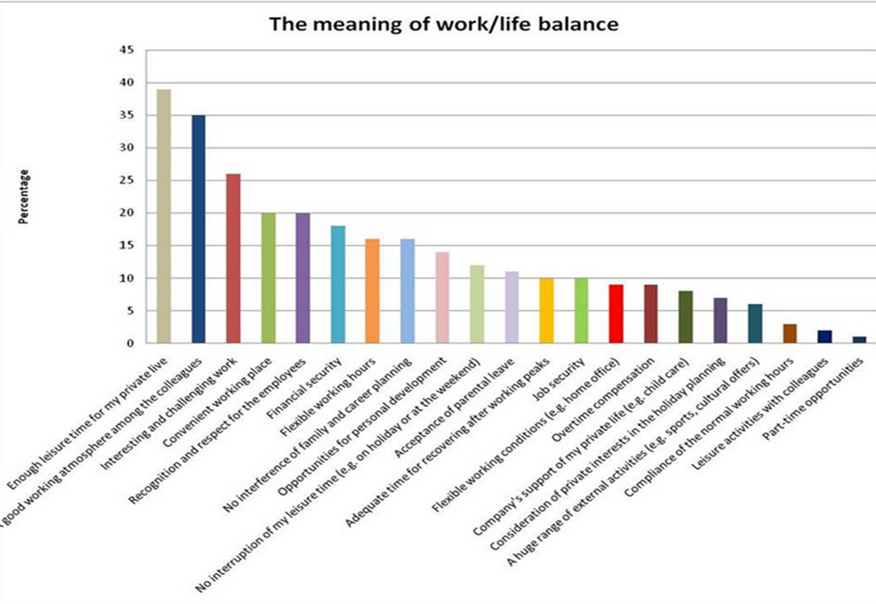

Slide 8
Activity 1:
Ideal Balance
Self
Home
Work

Slide 9
Page 2:
Maintaining Balance
Reflect on and answer questions 3 through 5.

Slide 10
Challenges to Work/Life Balance
Unclear Expectations
Meeting & Event Schedules
Technology
Being new
These could be your expectations or someone else's expectations for you.
You may not know what to prioritize. Trying to prove yourself.
Can frequently fall on evenings and weekends.
We now live in a constantly connected world.

Slide 11
THINK ABOUT...
1. How do you know if you have
work/life balance?
2. How do you know if you don't?

Slide 13
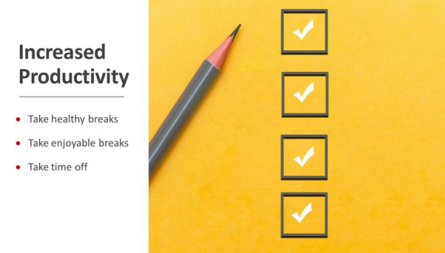

Slide 14
WORK STRATEGIES
RESPECT TIME OFF
(YOURS AND YOUR COWORKERS)
TEACH SOME CLASSES THAT YOU LOVE
ASK QUESTIONS!

Slide 15
What are other self-care work strategies that you use?

Slide 16
WORK & LIFE STRATEGIES
TIME MANAGEMENT
PRIORITIZE TASKS
SET BOUNDARIES

Slide 17
What are other personal life strategies that you use?

Slide 18
WELL-BEING STRATEGIES
SET REALISTIC EXPECTATIONS
EXCERCISE
DRINK WATER
TIME MANAGEMENT & TASK PRIORITIZATION
NURTURE RELATIONSHIPS
SET BOUNDARIES
EAT WELL
FIND A HOBBY

Slide 19
What are other strategies that you use to preserve your
well-being?

Slide 20
3 Minute Reset
Set a timer for 3 minutes and clean up as much clutter in your immediate space as you can in those 3 mins.

Slide 21
It is okay to say 'No'
(to some things)
Acknowledge the request.
Decline with a reason.
Suggest alternatives.
Talk to your supervisor and your regional program leaders as you learn which activities to prioritize.

Slide 22
It is okay to say 'No'
"Thank you so much for inviting me to speak at Grand-families Night. I would have loved to, but I already have a commitment that evening. Donna at the Health Department has a really great presentation on nutrition. I can get you her contact information so you can see if she is available. Please keep me in mind for next year!"

Slide 23
Communicate
Use your Outlook Calendar
Share Your Schedule
Ask Questions
Clarify Expectations
Learn Office Procedures
Express Needs
Ask for Help
Be Specific and Clear
The Bottom Line

Slide 24
Sometimes "Life" feels like work
High demands in personal life
Parenting
Taking care of elderly parents
Volunteer work
School demands
Relationships
Health Problems
Societal Pressure
Mental Health issues
Etc....

Slide 25
EAP
https://hr.utk.edu/employee-assistance-program/ ​
Available to all benefits-eligible UT employees, spouses and children.
Here4TN can provide assistance for many things including:
Depression, anxiety, and stress​
Family concerns​
Financial issues​
Managing chronic health conditions​
Separation and divorce​
Grief and loss​
Sleep issues
Wills and Advanced Directives​
Health and Wellness Incentives
Legal Consultations

Slide 26
Activity 3: Think & Plan
What is your take away?
WHAT ARE YOU GOING TO INCORPORATE IN YOUR LIFE?

Slide 27
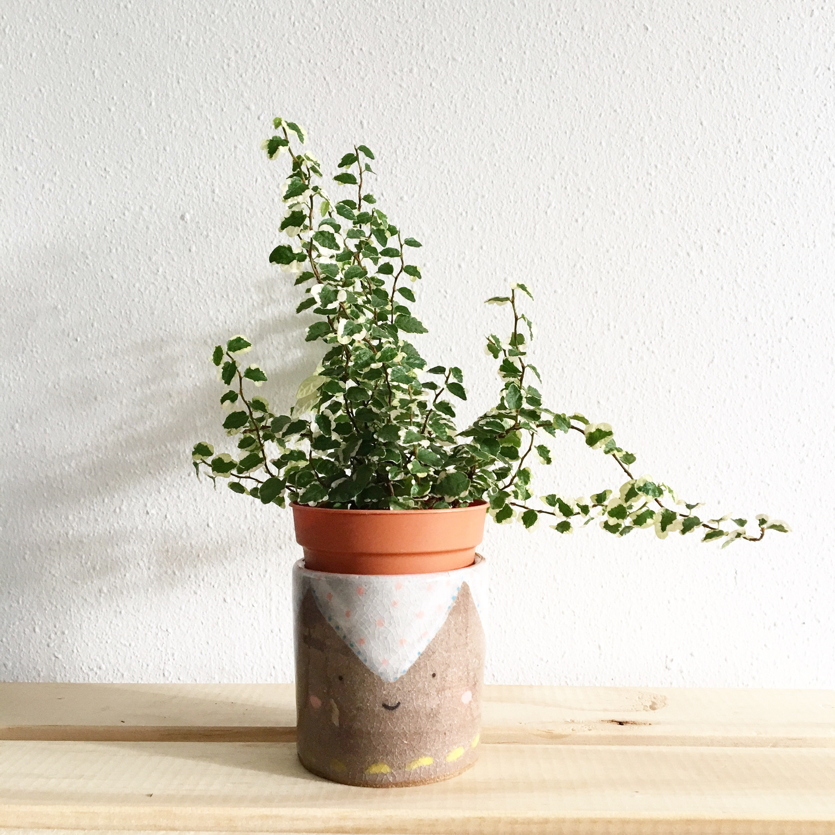
QUESTIONS? COMMENTS?

